Slide 1
The Platform Inside and Out
Release 0.13
Joshua Patterson – Director, RAPIDS Engineering
Notes:
https://rapids.ai/ https://github.com/rapidsai

Slide 2

RAPIDS
End-to-End Accelerated GPU Data Science
Data Preparation
Model Training
Visualization
Dask
cuDF cuIO
Analytics
cuML
Machine Learning
cuGraph
Graph Analytics
PyTorch Chainer MxNet
Deep Learning
cuxfilter <> pyViz
Visualization
GPU Memory

Slide 3
Data Processing Evolution
Faster data access, less data movement
Hadoop Processing, Reading from disk
HDFS Read
Query
HDFS Write
HDFS Read
ETL
HDFS Write
HDFS Read
ML Train
Spark In-Memory Processing
25-100x Improvement
Less code
Language flexible
Primarily In-Memory
HDFS Read
Query
ETL
ML Train
Traditional GPU Processing
5-10x Improvement
More code
Language rigid
Substantially on GPU
HDFS Read
GPU
Read
Query
CPU
Write
GPU
Read
ETL
CPU
Write
GPU
Read
ML
Train

Slide 4

Data Movement and Transformation
Data Movement and Transformation
The bane of productivity and performance
APP B
Read Data
APP B
APP A
GPU Data
APP B
Copy & Convert
CPU
GPU
Copy & Convert
GPU Data
APP A
Copy & Convert
APP A
Load Data

Slide 5
Data Movement and Transformation
Data Movement and Transformation
What if we could keep data on the GPU?
APP B
Read Data
APP B
APP A
GPU Data
APP B
Copy & Convert
CPU
GPU
Copy & Convert
Copy & Convert
GPU Data
APP A
Copy & Convert
APP A
Load Data

Slide 6

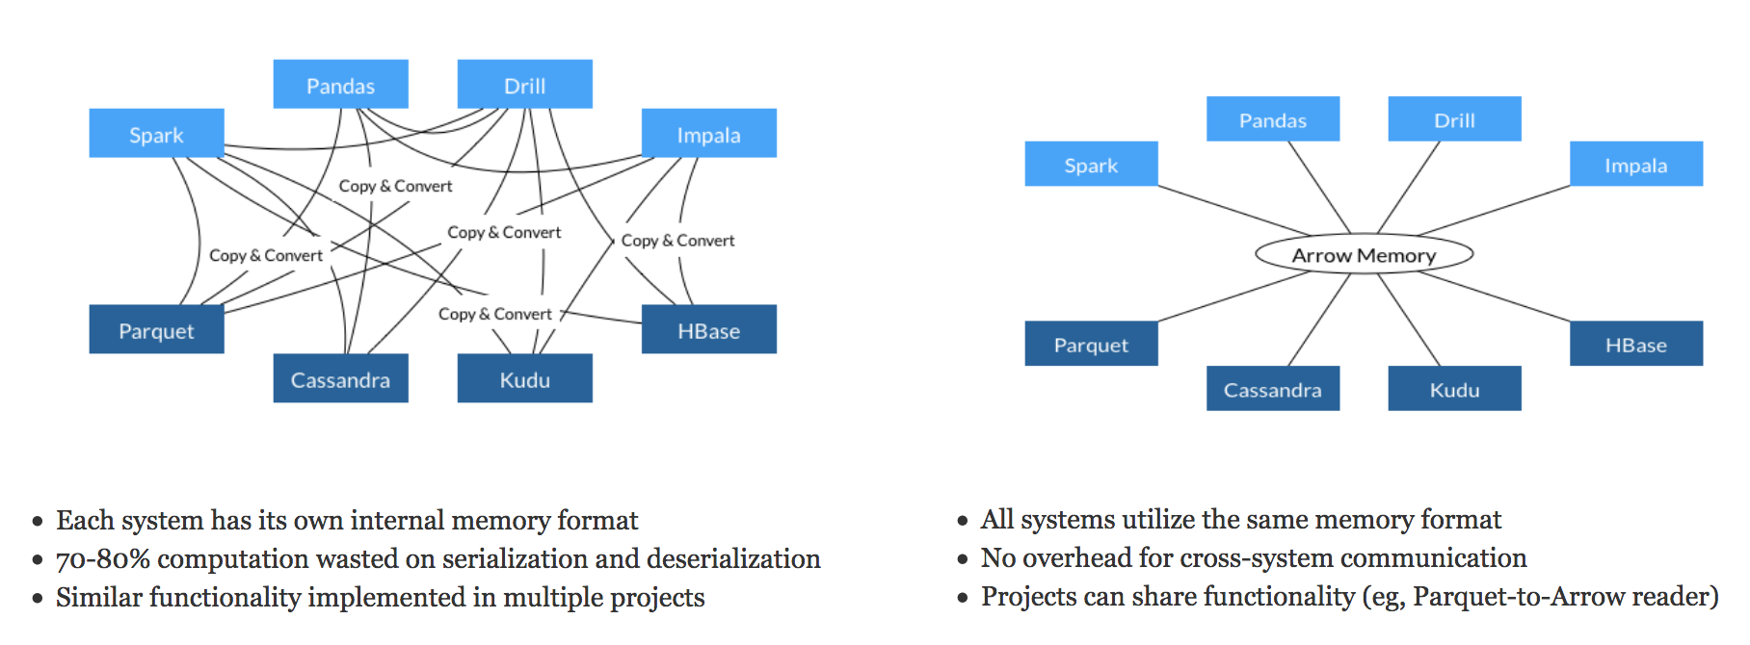
Learning from Apache Arrow
Each system has its own internal memory format
70-80% computation wasted on serialization and deserialization
Similar functionality implemented in multiple projects
All systems utilize the same memory format
No overhead for cross-system communication
Projects can share functionality (eg, Parquet-to-Arrow reader)
From Apache Arrow Home Page - https://arrow.apache.org/
Notes:
But others were discovering this as each system had its own way of handling data. You could use up to 80% of your compute in just copy and conversion

Slide 7
Data Processing Evolution
Faster data access, less data movement
Hadoop Processing, Reading from disk
HDFS Read
Query
HDFS Write
HDFS Read
ETL
HDFS Write
HDFS Read
ML Train
Spark In-Memory Processing
25-100x Improvement
Less code
Language flexible
Primarily In-Memory
HDFS Read
Query
ETL
ML Train
Traditional GPU Processing
5-10x Improvement
More code
Language rigid
Substantially on GPU
HDFS Read
GPU
Read
Query
CPU
Write
GPU
Read
ETL
CPU
Write
GPU
Read
ML
Train
RAPIDS
50-100x Improvement
Same code
Language flexible
Primarily on GPU
Arrow
Read
Query
ETL
ML
Train

Slide 8
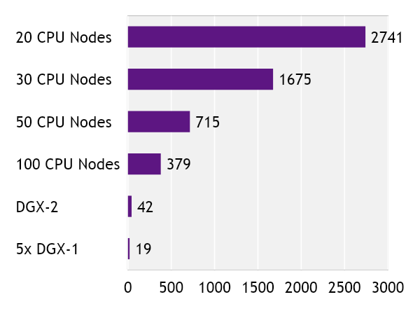
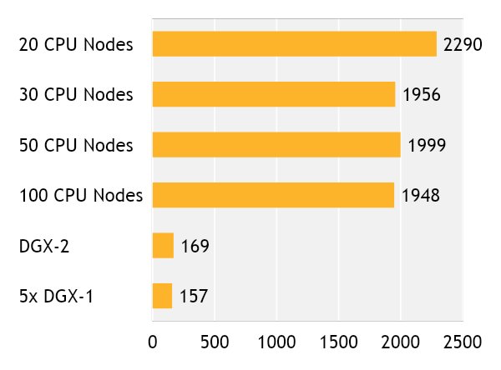
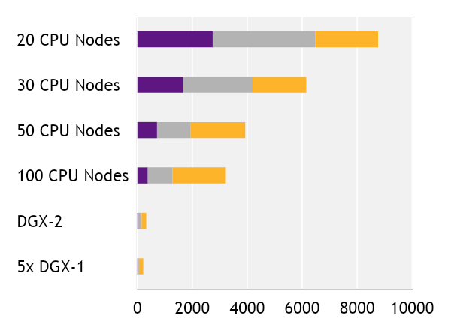
Faster Speeds, Real-World Benefits
cuIO/cuDF –
Load and Data Preparation
XGBoost Machine Learning
End-to-End
8762
6148
3925
3221
322
213
Time in seconds (shorter is better)
cuIO/cuDF (Load and Data Prep)
Data Conversion
XGBoost
Benchmark
CPU Cluster Configuration
DGX Cluster Configuration
200GB CSV dataset; Data prep includes joins, variable transformations
CPU nodes (61 GiB memory, 8 vCPUs, 64-bit platform), Apache Spark
5x DGX-1 on InfiniBand network

Slide 9
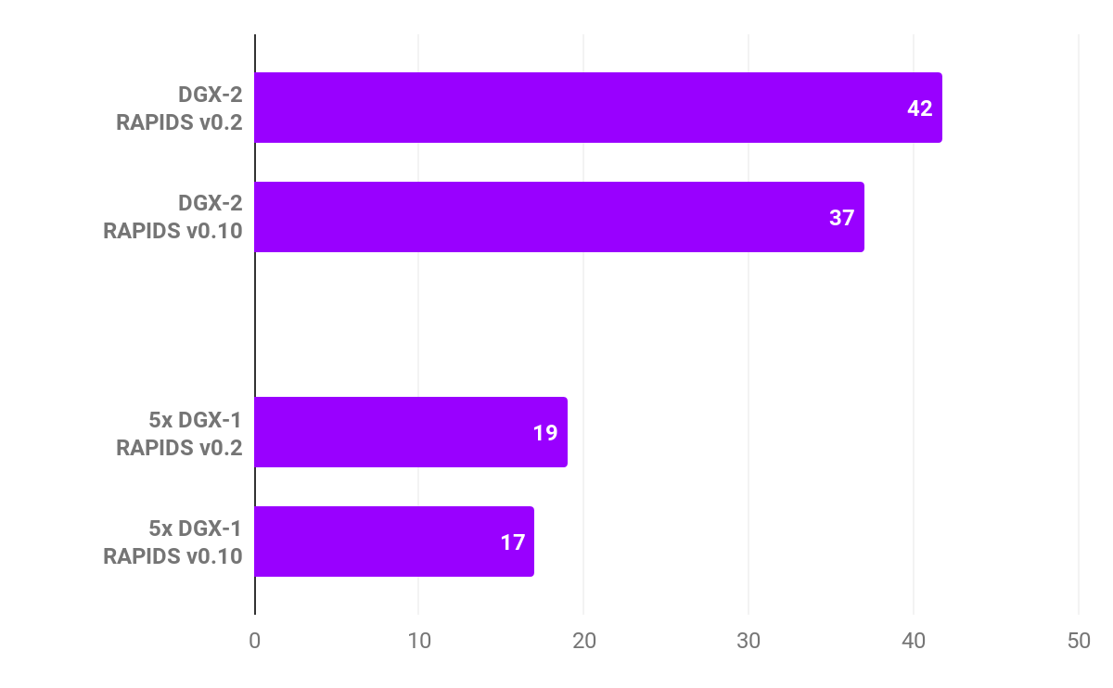
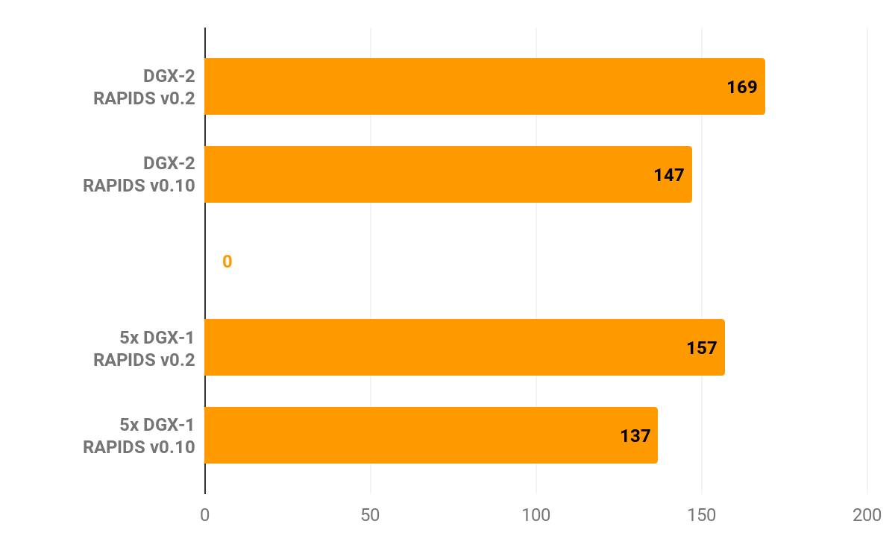
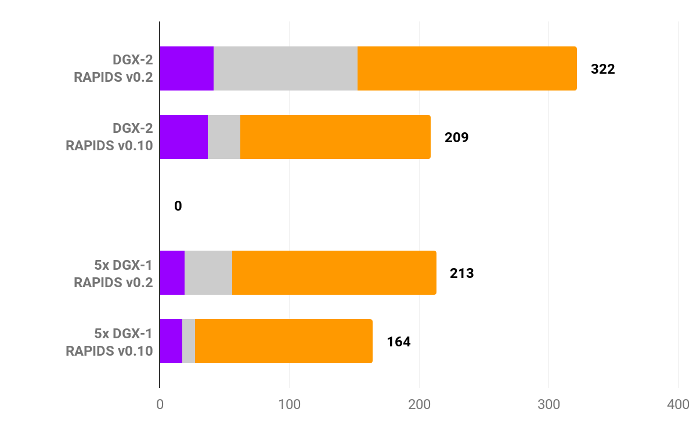
Faster Speeds, Real-World Benefits
Improving Over Time
cuIO/cuDF –
Load and Data Preparation
XGBoost Machine Learning
End-to-End
Time in seconds (shorter is better)
cuIO/cuDF (Load and Data Prep)
Data Conversion
XGBoost
Benchmark
CPU Cluster Configuration
DGX Cluster Configuration
200GB CSV dataset; Data prep includes joins, variable transformations
CPU nodes (61 GiB memory, 8 vCPUs, 64-bit platform), Apache Spark
5x DGX-1 on InfiniBand network

Slide 10
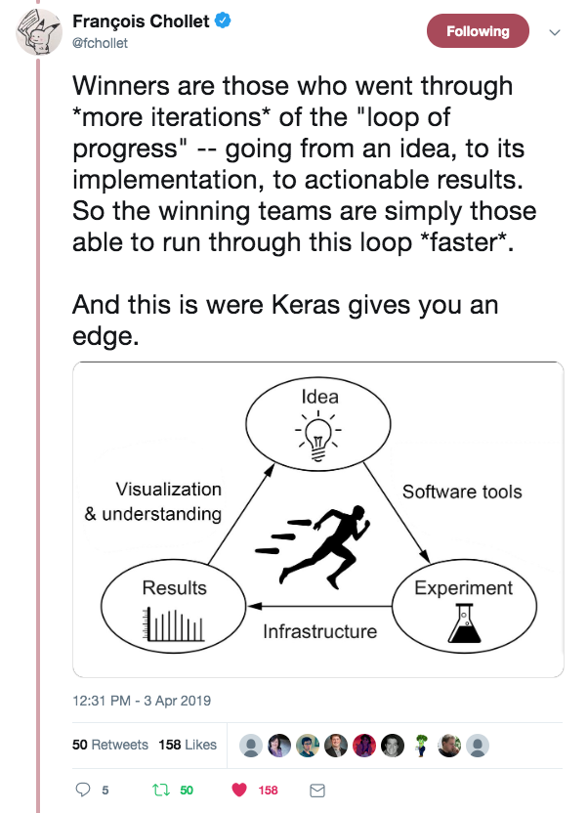
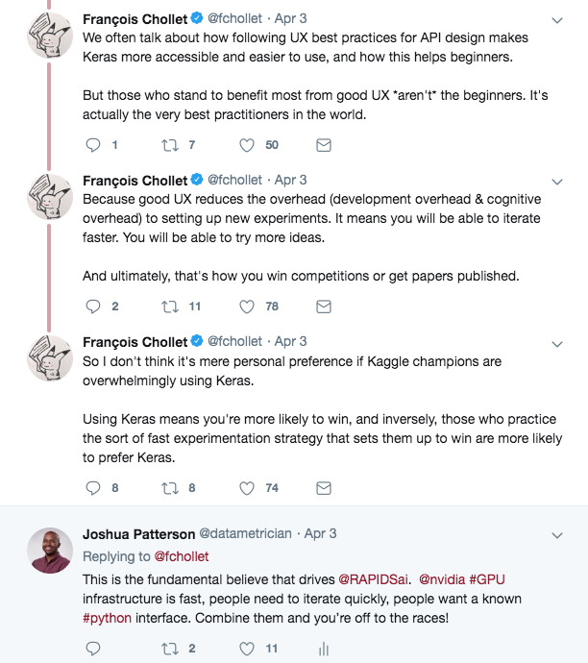
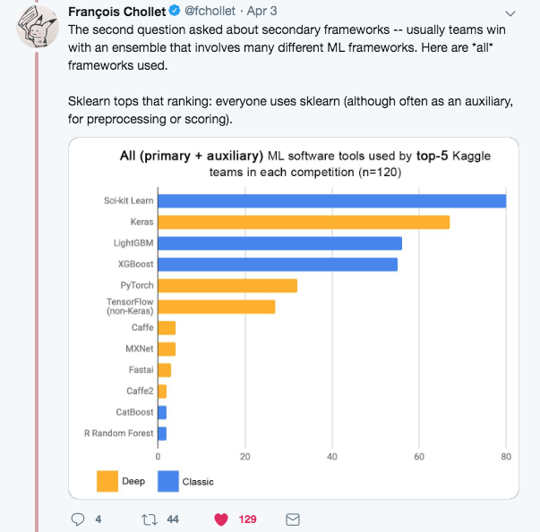

Speed, Ease of Use, and Iteration
The Way to Win at Data Science

Slide 11
RAPIDS 0.13 Release Summary

Slide 12
What’s New in Release 0.13?
cuDF Dataframes library python code base now ported to use the libcudf++ API, adds expanded groupby aggregations, join methods, concatenate optimizations, distributed multi column sorting and multi column hash repartitioning
cuML machine learning library adds new Dask API to XGBoost 1.0, new configurable types for estimators, and multi-node, multi-GPU support for linear models (PCA, tSVD, OLS, Ridge)
cuGraph graph analytics library adds betweenness centrality, K-Truss community detection, and code refactoring
UCX-Py focused on resolving Multi-Node Multi-GPU InfiniBand tests
BlazingSQL adds ROUND(), CASE with Strings, and for distributed queries AVG() support
cuSignal adds conda install support, polyphase resampler, and new acoustics module
cuSpatial adds batched cubic spline interpolation for trajectories and major documentation improvements

Slide 13
RAPIDS Core

Slide 14
Open Source Data Science Ecosystem
Familiar Python APIs
Data Preparation
Model Training
Visualization
Dask
Pandas
Analytics
Scikit-Learn
Machine Learning
NetworkX
Graph Analytics
PyTorch Chainer MxNet
Deep Learning
Matplotlib/Plotly
Visualization
CPU Memory

Slide 15
RAPIDS
End-to-End Accelerated GPU Data Science
Data Preparation
Model Training
Visualization
Dask
cuDF cuIO
Analytics
cuML
Machine Learning
cuGraph
Graph Analytics
PyTorch Chainer MxNet
Deep Learning
cuxfilter <> pyViz
Visualization
GPU Memory

Slide 16
Dask

Slide 17
RAPIDS
Scaling RAPIDS with Dask
Data Preparation
Model Training
Visualization
Dask
cuDF cuIO
Analytics
cuML
Machine Learning
cuGraph
Graph Analytics
PyTorch Chainer MxNet
Deep Learning
cuxfilter <> pyViz
Visualization
GPU Memory

Slide 18

Why Dask?
PyData Native
Easy Migration: Built on top of NumPy, Pandas Scikit-Learn, etc.
Easy Training: With the same APIs
Trusted: With the same developer community
Deployable
Easy Scalability
HPC: SLURM, PBS, LSF, SGE
Cloud: Kubernetes
Hadoop/Spark: Yarn
Easy to install and use on a laptop
Scales out to thousand-node clusters
Popular
Most common parallelism framework today in the PyData and SciPy community

Slide 19

Why OpenUCX?
Bringing hardware accelerated communications to Dask
TCP sockets are slow!
UCX provides uniform access to transports (TCP, InfiniBand, shared memory, NVLink)
Alpha Python bindings for UCX (ucx-py)
Will provide best communication performance, to Dask based on available hardware on nodes/cluster
conda install -c conda-forge -c rapidsai \
cudatoolkit=<CUDA version> ucx-proc=*=gpu ucx ucx-py

Slide 20
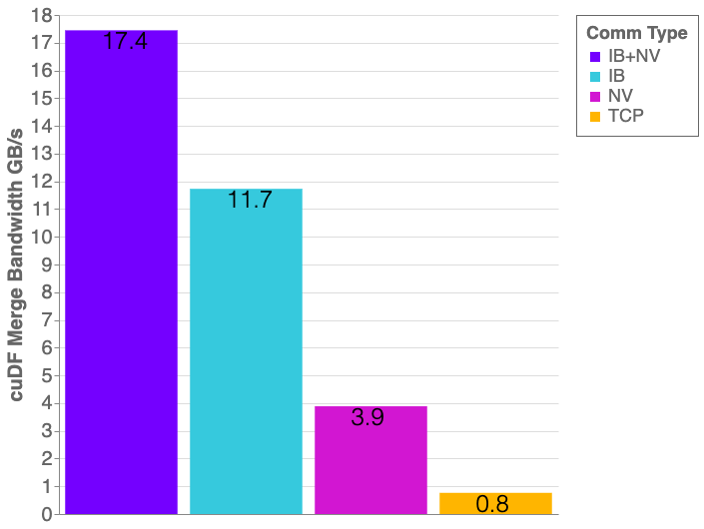
Benchmarks: Distributed cuDF Random Merge
cuDF v0.13, UCX-PY 0.13
Running on NVIDIA DGX-1 (8GPUs):
GPU: NVIDIA Tesla V100 32GB
CPU: Intel(R) Xeon(R) CPU 8168 @ 2.70GHz
Benchmark Setup:
DataFrames: Left/Right 1x int64 column key column, 1x int64 value columns
Merge: inner
30% of matching data balanced across each partition

Slide 21





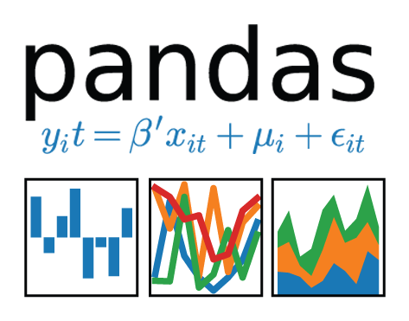
Scale up with RAPIDS
RAPIDS and Others
Accelerated on single GPU
NumPy -> CuPy/PyTorch/..
Pandas -> cuDF
Scikit-Learn -> cuML
Numba -> Numba
Scale Up / Accelerate
PyData
NumPy, Pandas, Scikit-Learn, Numba and many more
Single CPU core
In-memory data

Slide 22

Scale out with RAPIDS + Dask with OpenUCX
RAPIDS and Others
RAPIDS + Dask with OpenUCX
Accelerated on single GPU
NumPy -> CuPy/PyTorch/..
Pandas -> cuDF
Scikit-Learn -> cuML
Numba -> Numba
Multi-GPU
On single Node (DGX)
Or across a cluster
Scale Up / Accelerate
PyData
Dask
NumPy, Pandas, Scikit-Learn, Numba and many more
Single CPU core
In-memory data
Multi-core and Distributed PyData
NumPy -> Dask Array
Pandas -> Dask DataFrame
Scikit-Learn -> Dask-ML
… -> Dask Futures
Scale out / Parallelize

Slide 23
cuDF

Slide 24
RAPIDS
GPU Accelerated data wrangling and feature engineering
Data Preparation
Model Training
Visualization
Dask
cuDF cuIO
Analytics
cuML
Machine Learning
cuGraph
Graph Analytics
PyTorch Chainer MxNet
Deep Learning
cuxfilter <> pyViz
Visualization
GPU Memory

Slide 25
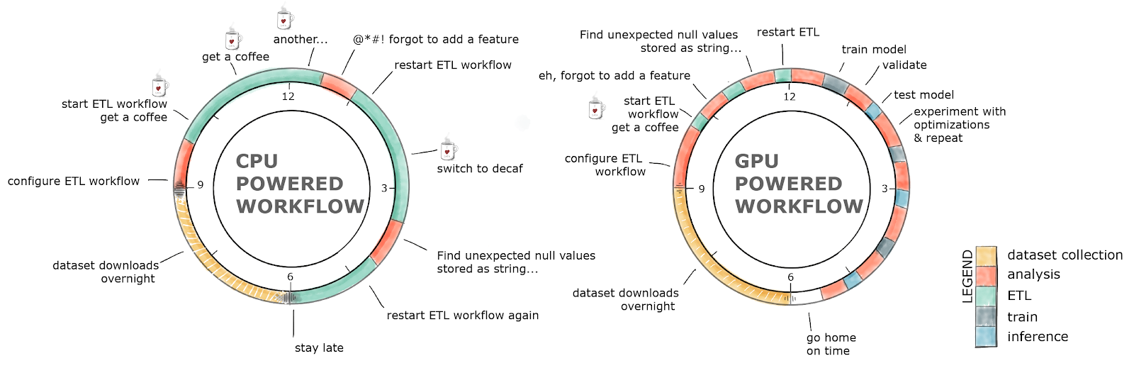
GPU-Accelerated ETL
The average data scientist spends 90+% of their time in ETL as opposed to training models

Slide 26
ETL Technology Stack
Dask cuDF
cuDF
Pandas
Python
Cython
cuDF C++
Thrust
Cub
Jitify
CUDA Libraries
CUDA

Slide 27



ETL: the Backbone of Data Science
libcuDF is…
CUDA C++ Library
Table (dataframe) and column types and algorithms
CUDA kernels for sorting, join, groupby, reductions, partitioning, elementwise operations, etc.
Optimized GPU implementations for strings, timestamps, numeric types (more coming)
Primitives for scalable distributed ETL
std::unique_ptr<table>
gather(table_view const& input,
column_view const& gather_map, …)
{
// return a new table containing
// rows from input indexed by // gather_map
}

Slide 28
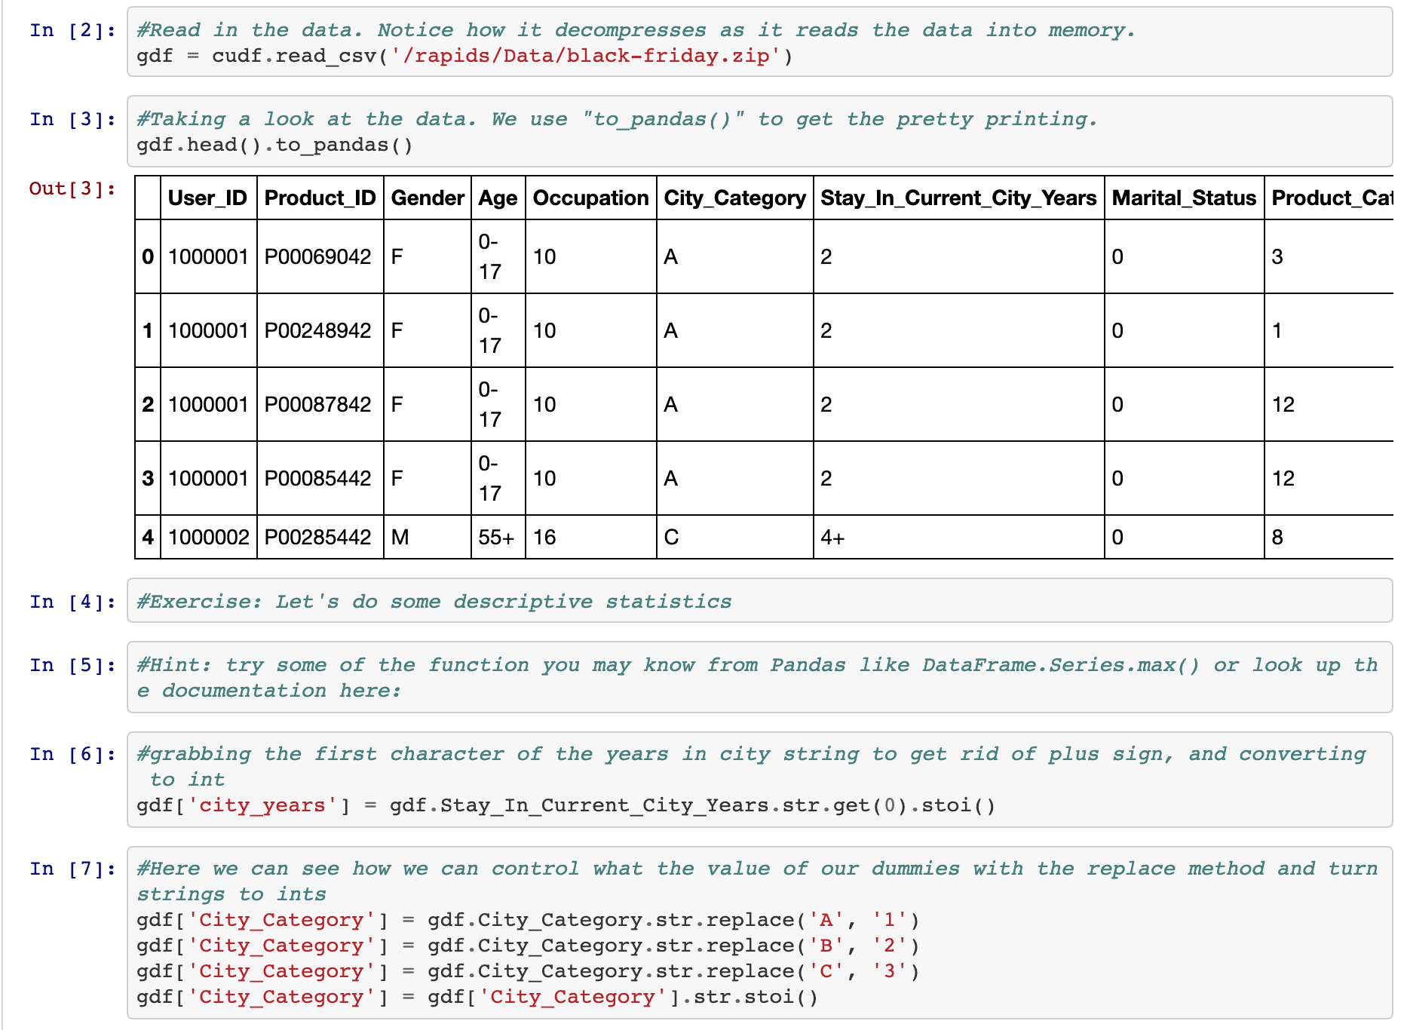
ETL: the Backbone of Data Science
cuDF is…
Python Library
A Python library for manipulating GPU DataFrames following the Pandas API
Python interface to CUDA C++ library with additional functionality
Creating GPU DataFrames from Numpy arrays, Pandas DataFrames, and PyArrow Tables
JIT compilation of User-Defined Functions (UDFs) using Numba

Slide 29
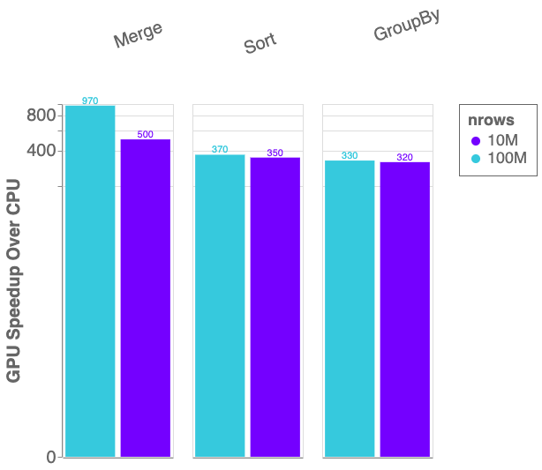
Benchmarks: single-GPU Speedup vs. Pandas
cuDF v0.13, Pandas 0.25.3
Running on NVIDIA DGX-1:
GPU: NVIDIA Tesla V100 32GB
CPU: Intel(R) Xeon(R) CPU E5-2698 v4 @ 2.20GHz
Benchmark Setup:
RMM Pool Allocator Enabled
DataFrames: 2x int32 columns key columns, 3x int32 value columns
Merge: inner
GroupBy: count, sum, min, max calculated for each value column

Slide 30
ETL: the Backbone of Data Science
cuDF is not the end of the story
Data Preparation
Model Training
Visualization
Dask
cuDF cuIO
Analytics
cuML
Machine Learning
cuGraph
Graph Analytics
PyTorch Chainer MxNet
Deep Learning
cuxfilter <> pyViz
Visualization
GPU Memory

Slide 31
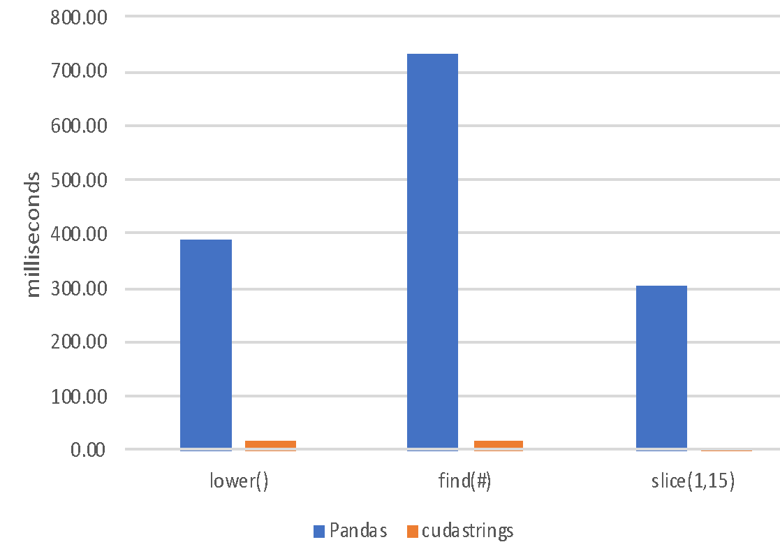
ETL: the Backbone of Data Science
String Support
Current v0.13 String Support
Regular Expressions
Element-wise operations
Split, Find, Extract, Cat, Typecasting, etc…
String GroupBys, Joins, Sorting, etc.
Categorical columns fully on GPU
Native String type in libcudf C++
Future v0.14+ String Support
Further performance optimization
JIT-compiled String UDFs

Slide 32
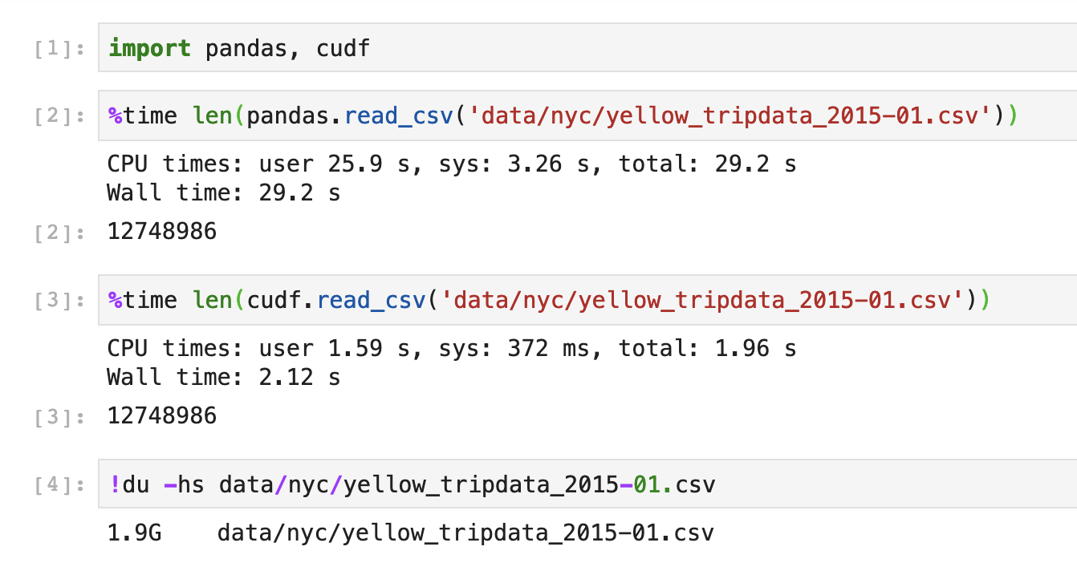
Extraction is the Cornerstone
cuDF I/O for Faster Data Loading
Follow Pandas APIs and provide >10x speedup
CSV Reader - v0.2, CSV Writer v0.8
Parquet Reader – v0.7, Parquet Writer v0.12
ORC Reader – v0.7, ORC Writer v0.10
JSON Reader - v0.8
Avro Reader - v0.9
GPU Direct Storage integration in progress for bypassing PCIe bottlenecks!
Key is GPU-accelerating both parsing and decompression wherever possible
Source: Apache Crail blog: SQL Performance: Part 1 - Input File Formats
Notes:
TSVD – truncated Singular Value Decomposition DBSCAN - Density-Based Spatial Clustering of Applications with Noise

Slide 33
ETL is not just DataFrames!

Slide 34
RAPIDS
Building bridges into the array ecosystem
Data Preparation
Model Training
Visualization
Dask
cuDF cuIO
Analytics
cuML
Machine Learning
cuGraph
Graph Analytics
PyTorch Chainer MxNet
Deep Learning
cuxfilter <> pyViz
Visualization
GPU Memory

Slide 35







Interoperability for the Win
DLPack and __cuda_array_interface__
mpi4py

Slide 36
Interoperability for the Win
DLPack and __cuda_array_interface__
mpi4py

Slide 37

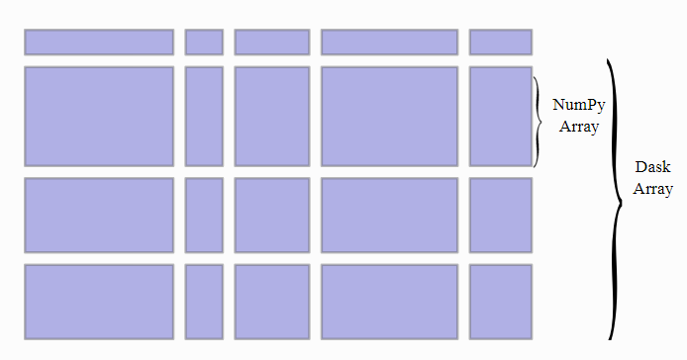
ETL: Arrays and DataFrames
Dask and CUDA Python arrays
Scales NumPy to distributed clusters
Used in climate science, imaging, HPC analysis up to 100TB size
Now seamlessly accelerated with GPUs

Slide 38
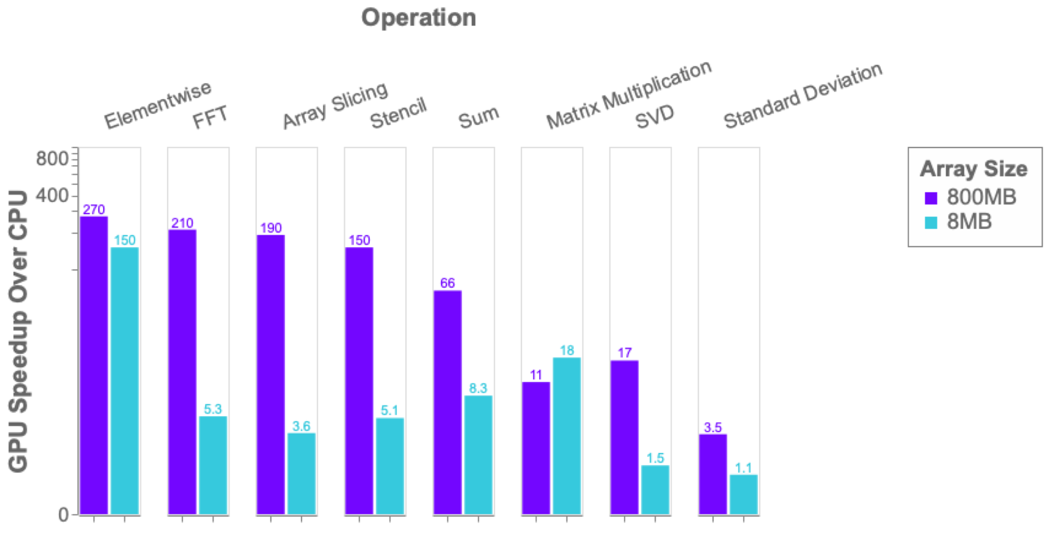
Benchmark: single-GPU CuPy vs NumPy
More details: https://blog.dask.org/2019/06/27/single-gpu-cupy-benchmarks

Slide 39
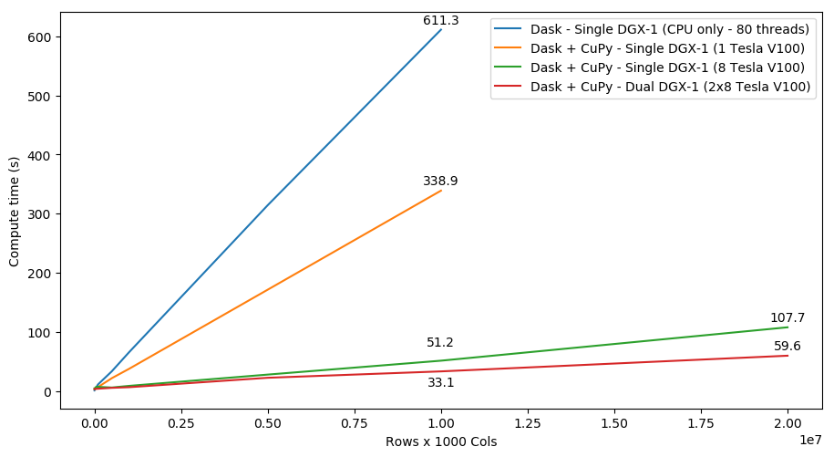
SVD Benchmark
Dask and CuPy Doing Complex Workflows

Slide 40
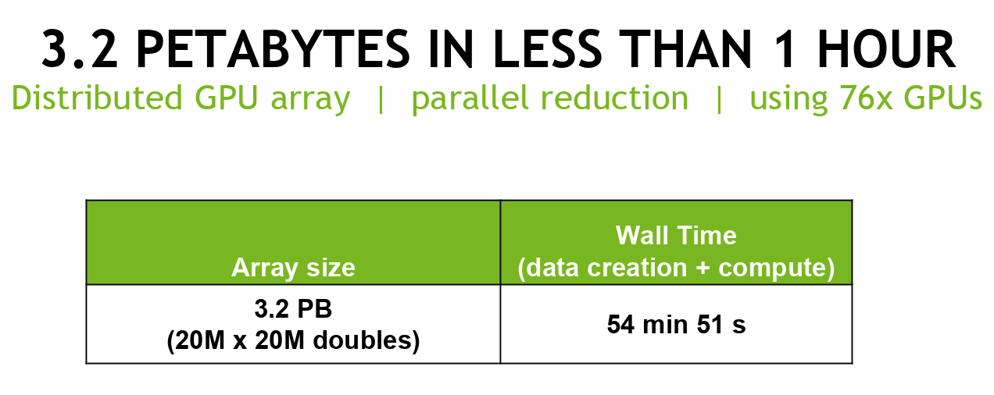
Petabyte Scale Analytics with Dask and CuPy
Architecture | Time
Single CPU Core | 2hr 39min
Forty CPU Cores | 11min 30s
One GPU | 1min 37s
Eight GPUs | 19s
Cluster configuration: 20x GCP instances, each instance has:
CPU: 1 VM socket (Intel Xeon CPU @ 2.30GHz), 2-core, 2 threads/core, 132GB mem, GbE ethernet, 950 GB disk
GPU: 4x NVIDIA Tesla P100-16GB-PCIe (total GPU DRAM across nodes 1.22 TB)
Software: Ubuntu 18.04, RAPIDS 0.5.1, Dask=1.1.1, Dask-Distributed=1.1.1, CuPY=5.2.0, CUDA 10.0.130
https://blog.dask.org/2019/01/03/dask-array-gpus-first-steps

Slide 41
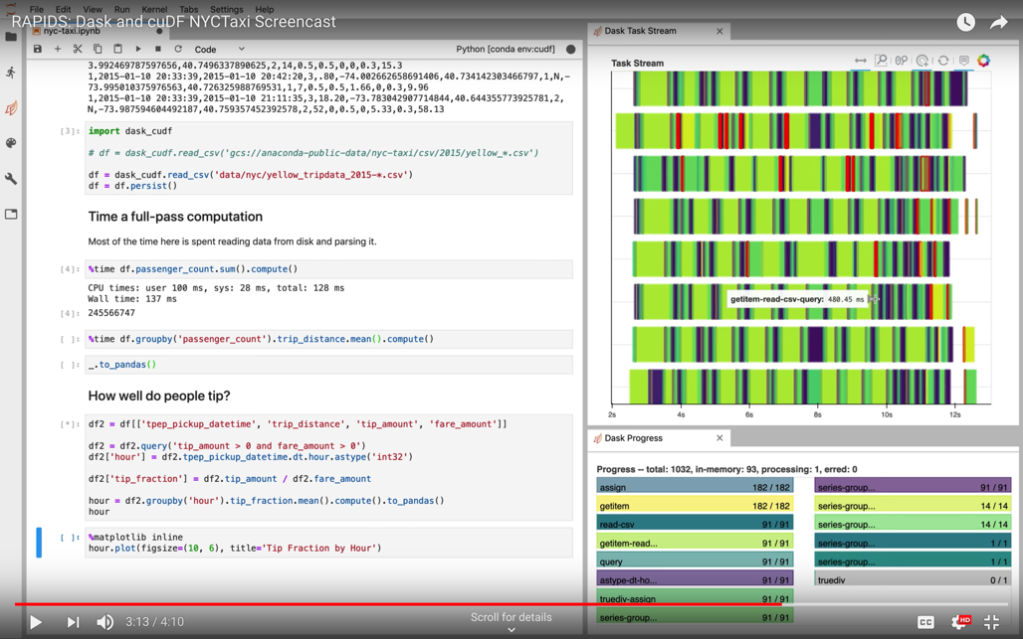
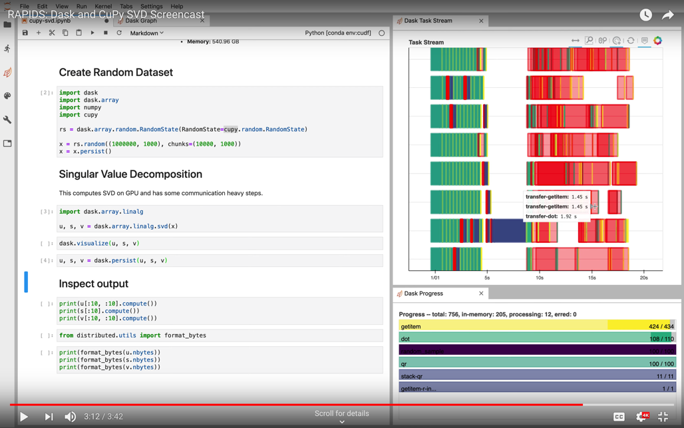
ETL: Arrays and DataFrames
More Dask Awesomeness from RAPIDS
https://youtu.be/gV0cykgsTPM
https://youtu.be/R5CiXti_MWo

Slide 42
cuML

Slide 43
Machine Learning
More models more problems
Data Preparation
Model Training
Visualization
Dask
cuDF cuIO
Analytics
cuML
Machine Learning
cuGraph
Graph Analytics
PyTorch Chainer MxNet
Deep Learning
cuxfilter <> pyViz
Visualization
GPU Memory

Slide 44


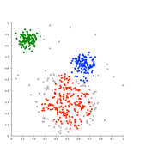
Problem
Data sizes continue to grow
Massive Dataset
Histograms / Distributions
Better to start with as much data as
possible and explore / preprocess to scale
to performance needs.
Dimension Reduction
Feature Selection
Time
Increases
Remove Outliers
Iterate. Cross Validate & Grid Search.
Iterate some more.
Hours? Days?
Sampling
Meet reasonable speed vs accuracy tradeoff
Notes:
Several iterations through our preprocessing, exploration, and training cycle could even take weeks! I’ve been on projects solving complex problems where months would pass before any valuable insight is gained- attributed almost entirely to computation time!

Slide 45
ML Technology Stack
Python
Dask cuML Dask cuDF
cuDF
Numpy
Cython
cuML Algorithms
Thrust
Cub
cuSolver
nvGraph
CUTLASS
cuSparse
cuRand
cuBlas
cuML Prims
CUDA Libraries
CUDA

Slide 46

Algorithms
GPU-accelerated Scikit-Learn
Classification / Regression
Decision Trees / Random Forests
Linear Regression
Logistic Regression
K-Nearest Neighbors
Support Vector Machines
Random forest / GBDT inference
Inference
Clustering
K-Means
DBSCAN
Spectral Clustering
Principal Components
Singular Value Decomposition UMAP
Spectral Embedding
T-SNE
Decomposition & Dimensionality Reduction
Cross Validation
Time Series
Holt-Winters
Seasonal ARIMA
Hyper-parameter Tuning
Key:
Preexisting
NEW or enhanced for 0.13
More to come!
Notes:
In the C++ Algorithms side, you'll find full machine learning algorithms such as classification & regression, statistical inference, clustering, dimensionality reduction, timeseries forecasting, & recommendations. We'll have cross validation very soon and much more.

Slide 47
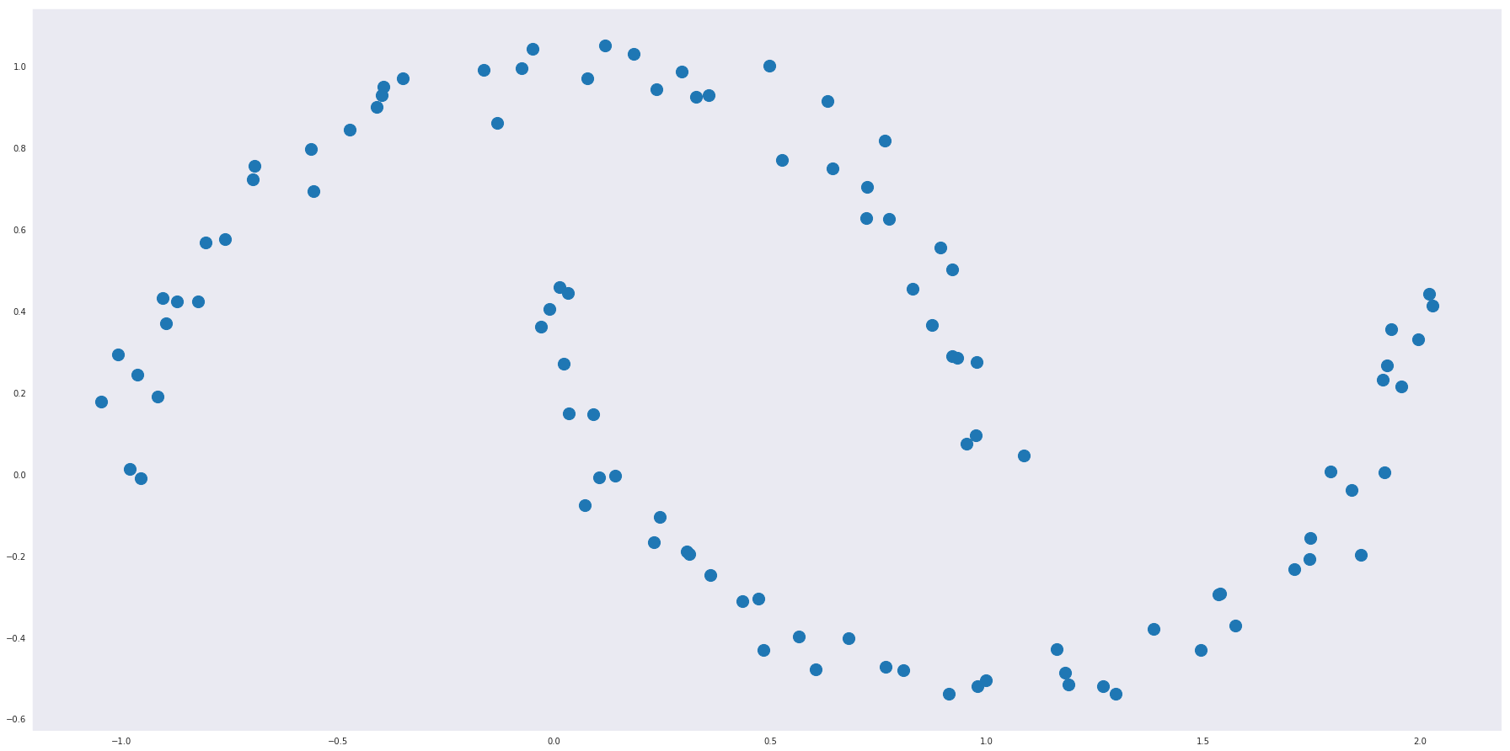
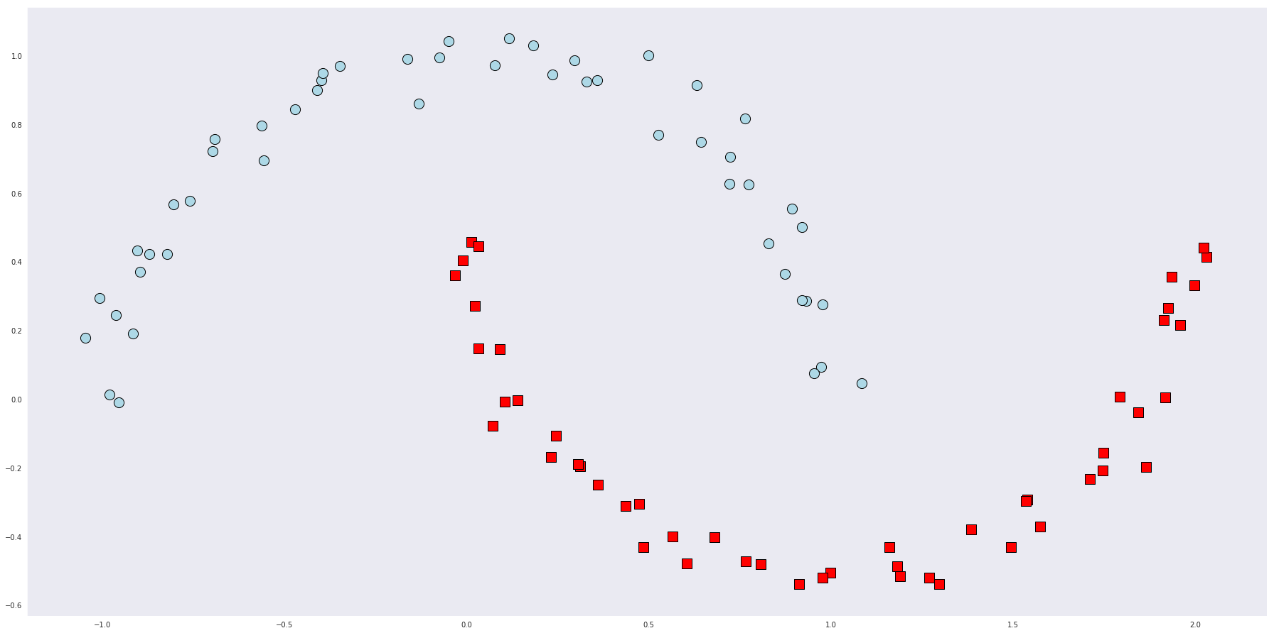
RAPIDS matches common Python APIs
CPU-Based Clustering
from sklearn.datasets import make_moons import pandas
X, y = make_moons(n_samples=int(1e2), noise=0.05, random_state=0) X = pandas.DataFrame({'fea%d'%i: X[:, i] for i in range(X.shape[1])})
Find Clusters
from sklearn.cluster import DBSCAN dbscan = DBSCAN(eps = 0.3, min_samples = 5) dbscan.fit(X) y_hat = dbscan.predict(X)
Notes:
And our resulting clusters.

Slide 48
RAPIDS matches common Python APIs
GPU-Accelerated Clustering
from sklearn.datasets import make_moons import cudf
X, y = make_moons(n_samples=int(1e2), noise=0.05, random_state=0) X = cudf.DataFrame({'fea%d'%i: X[:, i] for i in range(X.shape[1])})
Find Clusters
from cuml import DBSCAN dbscan = DBSCAN(eps = 0.3, min_samples = 5) dbscan.fit(X) y_hat = dbscan.predict(X)
Notes:
And our resulting clusters.

Slide 49
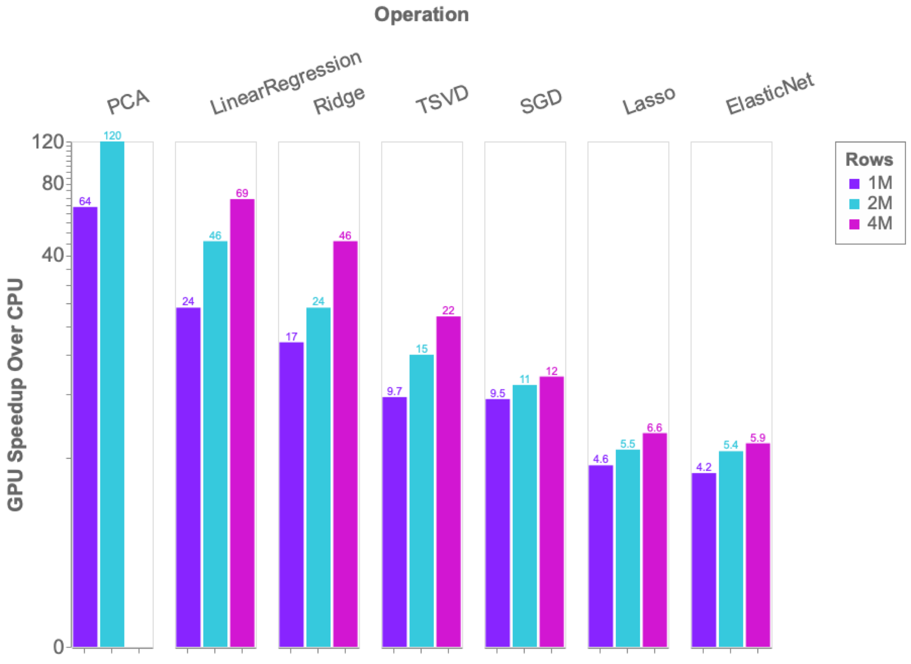
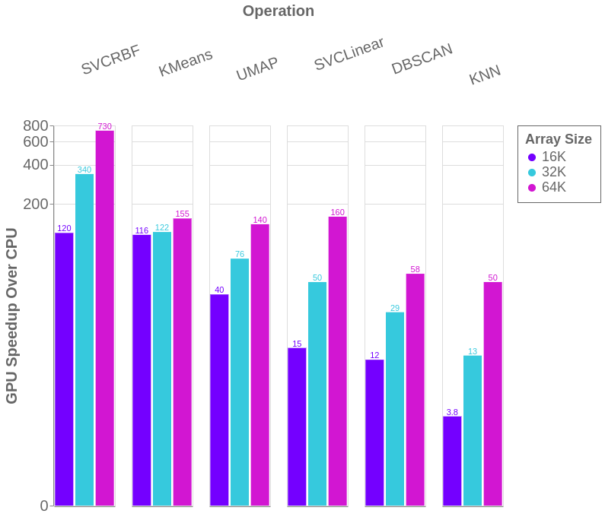
Benchmarks: single-GPU cuML vs scikit-learn
1x V100
vs.
2x 20 core CPU

Slide 50
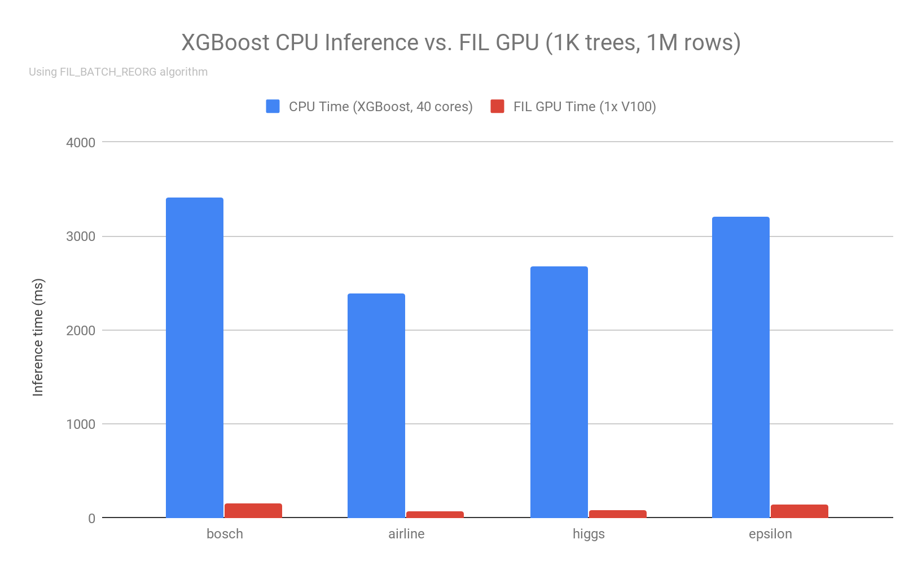
Forest Inference
Taking models from training to production
cuML’s Forest Inference Library accelerates prediction (inference) for random forests and boosted decision trees:
Works with existing saved models (XGBoost, LightGBM, scikit-learn RF cuML RF soon)
Lightweight Python API
Single V100 GPU can infer up to 34x faster than XGBoost dual-CPU node
Over 100 million forest inferences per sec (with 1000 trees) on a DGX-1 for large (sparse) or dense models
23x
36x
34x
23x
Notes:
Detailed blog: https://medium.com/rapids-ai/rapids-forest-inference-library-prediction-at-100-million-rows-per-second-19558890bc35?source=collection_home---6------0-----------------------
Sparse models blog: https://medium.com/rapids-ai/sparse-forests-with-fil-ffbb42b0c7e3 DGX-1, 2x E5-2698 v4 @ 2.20GHz, V100-32GB, using FIL BATCH_REORG algo, 1000 trees, max_depth=10
Trained in XGBoost using data from https://github.com/NVIDIA/gbm-bench
Added in Release 0.9

Slide 51


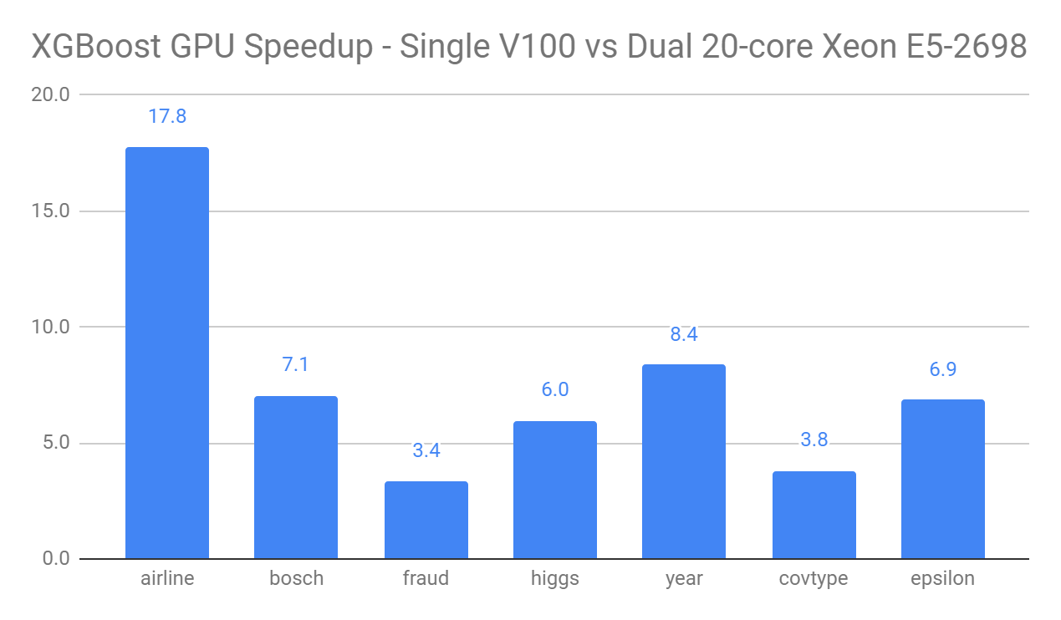

+
RAPIDS works closely with the XGBoost community to accelerate GBDTs on GPU
The default rapids conda metapackage includes XGBoost
XGBoost can seamlessly load data from cuDF dataframes and cuPy arrays
Dask allows XGBoost to scale to arbitrary numbers of GPUs
With the gpu_hist tree method, a single GPU can outpace 10s to 100s of CPUs
Version 1.0 of XGBoost launched with the RAPIDS 0.13 stack.
Notes:
See: https://rapids.ai/xgboost.html

Slide 52
Road to 1.0
March 2020 - RAPIDS 0.13
cuML | Single-GPU | Multi-GPU | Multi-Node-Multi-GPU
Gradient Boosted Decision Trees (GBDT)
Linear Regression
Logistic Regression
Random Forest
K-Means
K-NN
DBSCAN
UMAP
Holt-Winters
ARIMA
t-SNE
Principal Components
Singular Value Decomposition
SVM

Slide 53
Road to 1.0
2020 - RAPIDS 1.0
cuML | Single-GPU | Multi-Node-Multi-GPU
Gradient Boosted Decision Trees (GBDT)
Linear Regression (regularized)
Logistic Regression
Random Forest
K-Means
K-NN
DBSCAN
UMAP
Holt-Winters
ARIMA
t-SNE
Principal Components
Singular Value Decomposition
SVM

Slide 54
cuGraph

Slide 55
Graph Analytics
More connections more insights
Data Preparation
Model Training
Visualization
Dask
cuDF cuIO
Analytics
cuML
Machine Learning
cuGraph
Graph Analytics
PyTorch Chainer MxNet
Deep Learning
cuxfilter <> pyViz
Visualization
GPU Memory

Slide 56
Goals and Benefits of cuGraph
Focus on Features and User Experience
Breakthrough Performance
Multiple APIs
Up to 500 million edges on a single 32GB GPU
Multi-GPU support for scaling into the billions of edges
Python: Familiar NetworkX-like API
C/C++: lower-level granular control for application developers
Seamless Integration with cuDF and cuML
Growing Functionality
Property Graph support via DataFrames
Extensive collection of algorithm, primitive, and utility functions

Slide 57
Graph Technology Stack
Python
Dask cuGraph Dask cuDF
cuDF
Numpy
Cython
cuGraph Algorithms
Prims
cuGraphBLAS
cuHornet
thrust
cub
cuSolver
cuSparse
cuRand
Gunrock*
CUDA Libraries
CUDA
nvGRAPH has been Opened Sourced and integrated into cuGraph. A legacy version is available in a RAPIDS GitHub repo
* Gunrock is from UC Davis

Slide 58
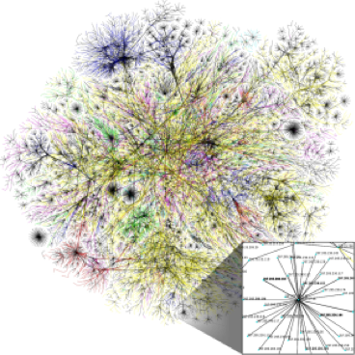
Algorithms
GPU-accelerated NetworkX
Spectral Clustering
Balanced-Cut
Modularity Maximization
Louvain
Ensemble Clustering for Graphs
Subgraph Extraction KCore and KCore Number
Triangle Counting
K-Truss
Community
Components
Weakly Connected Components
Strongly Connected Components
Link Analysis
Page Rank (Multi-GPU)
Personal Page Rank
Graph Classes
Structure
Link Prediction
Jaccard
Weighted Jaccard
Overlap Coefficient
Multi-GPU
Traversal
Single Source Shortest Path (SSSP)
Breadth First Search (BFS)
Renumbering
Auto-renumbering
Utilities
Centrality
Katz
Betweenness Centrality
More to come!

Slide 59
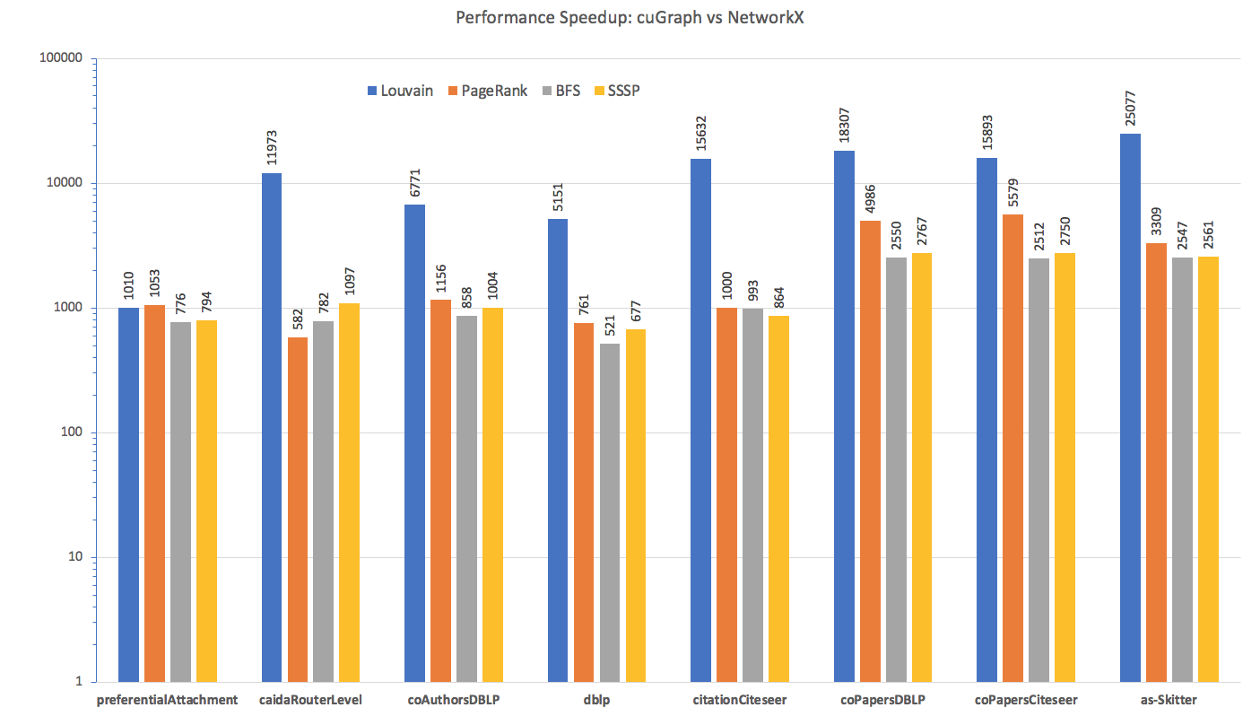
Benchmarks: single-GPU cuGraph vs NetworkX
Dataset | Nodes | Edges
preferentialAttachment | 100,000 | 999,970
caidaRouterLevel | 192,244 | 1,218,132
coAuthorsDBLP | 299,067 | 299,067
dblp-2010 | 326,186 | 1,615,400
citationCiteseer | 268,495 | 2,313,294
coPapersDBLP | 540,486 | 30,491,458
coPapersCiteseer | 434,102 | 32,073,440
as-Skitter | 1,696,415 | 22,190,596

Slide 60
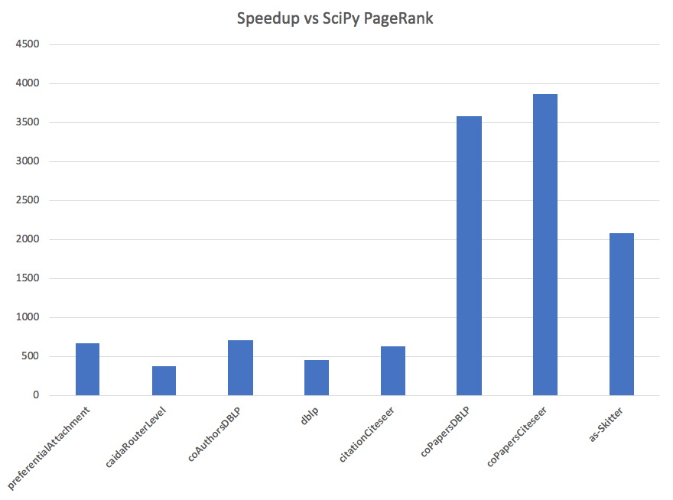
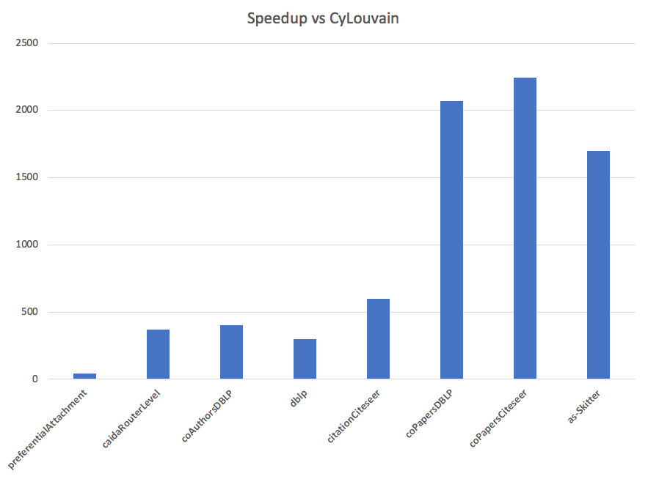
Benchmarks: cyLouvain and SciPy PageRank

Slide 61
Multi-GPU PageRank Performance
PageRank portion of the HiBench benchmark suite
HiBench Scale | Vertices | Edges | CSV File (GB) | # of V100 GPUs | # of CPU Threads | PageRank for 3 Iterations (secs)
Huge | 5,000,000 | 198,000,000 | 3 | 1 |  | 1.1
BigData | 50,000,000 | 1,980,000,000 | 34 | 3 |  | 5.1
BigData x2 | 100,000,000 | 4,000,000,000 | 69 | 6 |  | 9.0
BigData x4 | 200,000,000 | 8,000,000,000 | 146 | 12 |  | 18.2
BigData x8 | 400,000,000 | 16,000,000,000 | 300 | 16 |  | 31.8
BigData x8 | 400,000,000 | 16,000,000,000 | 300 |  | 800* | 5760*
*BigData x8, 100x 8-vCPU nodes, Apache Spark GraphX ⇒ 96 mins!

Slide 62
Road to 1.0
March 2020 - RAPIDS 0.13
cuGraph | Single-GPU | Multi-GPU | Multi-Node-Multi-GPU
PageRank
Personal Page Rank
Katz
Betweenness Centrality
Spectral Clustering
Louvain
Ensemble Clustering for Graphs
K-Core
K-Truss
Triangle Counting
Connected Components (Weak and Strong)
Jaccard
Overlap Coefficent
Single Source Shortest Path (SSSP)
Breadth First Search (BFS)

Slide 63
Road to 1.0
March 2020 - RAPIDS 1.0
cuGraph | Single-GPU | Multi-Node-Multi-GPU
PageRank
Personal Page Rank
Katz
Betweenness Centrality
Spectral Clustering
Louvain
Ensemble Clustering for Graphs
K-Core
K-Truss
Triangle Counting
Connected Components (Weak and Strong)
Jaccard
Overlap Coefficent
Single Source Shortest Path (SSSP)
Breadth First Search (BFS)

Slide 64
cuSpatial

Slide 65
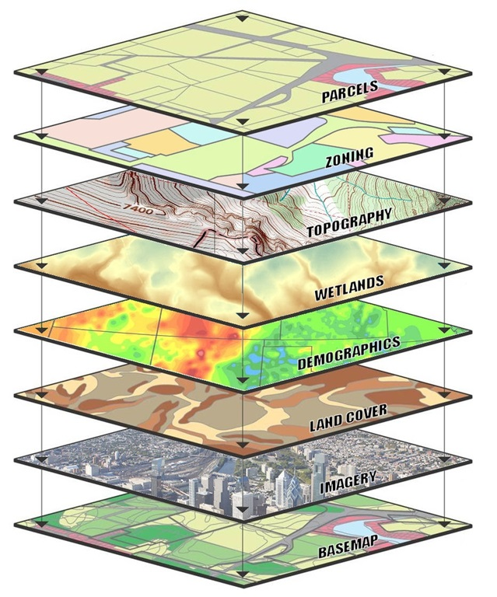
cuSpatial
Breakthrough Performance & Ease of Use
Up to 1000x faster than CPU spatial libraries
Python and C++ APIs for maximum usability and integration
Growing Functionality
Extensive collection of algorithm, primitive, and utility functions for spatial analytics
Seamless Integration into RAPIDS
cuDF for data loading, cuGraph for routing optimization, and cuML for clustering are just a few examples

Slide 66
cuSpatial Technology Stack
Python
Cython
cuSpatial
cuDF C++
Thrust
CUDA

Slide 67
cuSpatial
0.13 and Beyond
Layer | 0.13 Functionality | Functionality Roadmap (2020)
High-level Analytics | C++ Library w. Python bindings enabling distance, speed, trajectory similarity, trajectory clustering | C++ Library w. Python bindings for additional spatio-temporal trajectory clustering, acceleration, dwell-time, salient locations, trajectory anomaly detection, origin destination, etc.
Graph layer | cuGraph | Map matching, Djikstra algorithm, Routing
Query layer | Spatial Window | Nearest Neighbor,KNN, Spatiotemporal range search and joins
Index layer |  | Grid, Quad Tree, R-Tree, Geohash, Voronoi Tessellation
Geo-operations | Point in polygon (PIP), Haversine distance, Hausdorff distance, lat-lon to xy transformation, spline interpolation | Line intersecting polygon, Other distance functions, Polygon intersection, union
Geo-representation | Shape primitives, points, polylines, polygons | Additional shape primitives

Slide 68
cuSpatial
Performance at a Glance
cuSpatial Operation | Input data | cuSpatial Runtime | Reference Runtime | Speedup
Point-in-Polygon Test | 1.3+ million vehicle point locations and 27 Region of Interests | 1.11 ms (C++) 1.50 ms (Python) [Nvidia Titan V] | 334 ms (C++, optimized serial) 130468.2 ms (python Shapely API, serial) [Intel i7-7800X] | 301X (C++) 86,978X (Python)
Haversine Distance Computation | 13+ million Monthly NYC taxi trip pickup and drop-off locations | 7.61 ms (Python) [Nvidia T4] | 416.9 ms (Numba) [Nvidia T4] | 54.7X (Python)
Hausdorff Distance Computation (for clustering) | 52,800 trajectories with 1.3+ million points | 13.5s [Quadro V100] | 19227.5s (Python SciPy API, serial) [Intel i7-6700K] | 1,400X (Python)

Slide 69
cuSignal

Slide 70
cuSignal Technology Stack
Python
Numba
CuPy
CUDA
Unlike other RAPIDS libraries, cuSignal is purely developed in Python
with custom CUDA Kernels written with Numba and CuPy (notice no Cython layer).
Notes:
Unlike the other RAPIDS libraries, cuSignal makes use of GPU accelerated PyData ecosystem (Numba and CuPy in particular) to innovate from the Python layer. There is currently no C++ or native CUDA in cuSignal. While we investigate if this makes sense in the long term, if you ‘re NOT interested in signal processing, one major takeaway is that you can build really great and fast GPU accelerated libraries for an arbitrary application without touching a low level language.

Slide 71

cuSignal – Selected Algorithms
GPU-accelerated SciPy Signal
Convolution
Convolve/Correlate
FFT Convolve
Convolve/Correlate 2D
Resampling – Polyphase, Upfirdn, Resample
Hilbert/Hilbert 2D
Wiener
Firwin
Filtering and Filter Design
Waveform Generation
Chirp
Square
Gaussian Pulse
Kaiser
Blackman
Hamming
Hanning
Window Functions
Wavelets
Spectral Analysis
Periodogram
Welch
Spectrogram
Peak Finding
More to come!
Notes:
This is a non-exhaustive list of features
Perf, 1e8 points (Python, using time, with garbage collection).
Fftconvolve – 76x
Correlate – 53x
Resample – 51x
Polyphase resample – 14x
Welch Spectrum estimation – 26x
Spectrogram – 15x
Continuous wavelet transform – 89x

Slide 72
Speed of Light Performance – V100
timeit (7 runs) rather than time. Benchmarked with ~1e8 sample signals on a DGX Station
Method | Scipy Signal (ms) | cuSignal (ms) | Speedup (xN)
fftconvolve | 28400 | 92.2 | 308.0
correlate | 16800 | 48.4 | 347.1
resample | 14700 | 51.1 | 287.7
resample_poly | 3110 | 13.7 | 227.0
welch | 4620 | 53.7 | 86.0
spectrogram | 2520 | 28 | 90.0
cwt | 46700 | 277 | 168.6
Learn more about cuSignal functionality and performance by browsing the notebooks

Slide 73
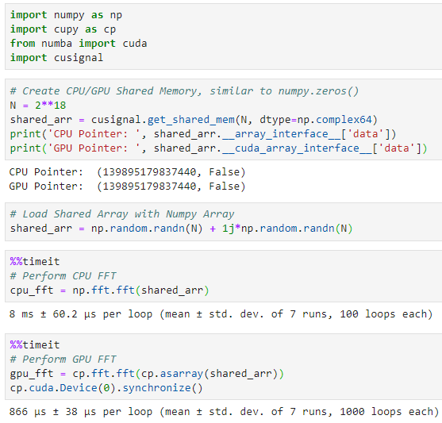
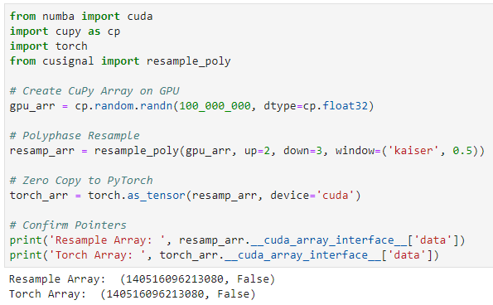
Efficient Memory Handling
Seamless Data Handoff from cuSignal to PyTorch >=1.4
Enabling Online Signal Processing with Zero-Copy Memory
Leveraging the __cuda_array_interface__ for Speed of Light End-to-End Performance
CPU <-> GPU Direct Memory Access with Numba’s Mapped Array

Slide 74
Community

Slide 75
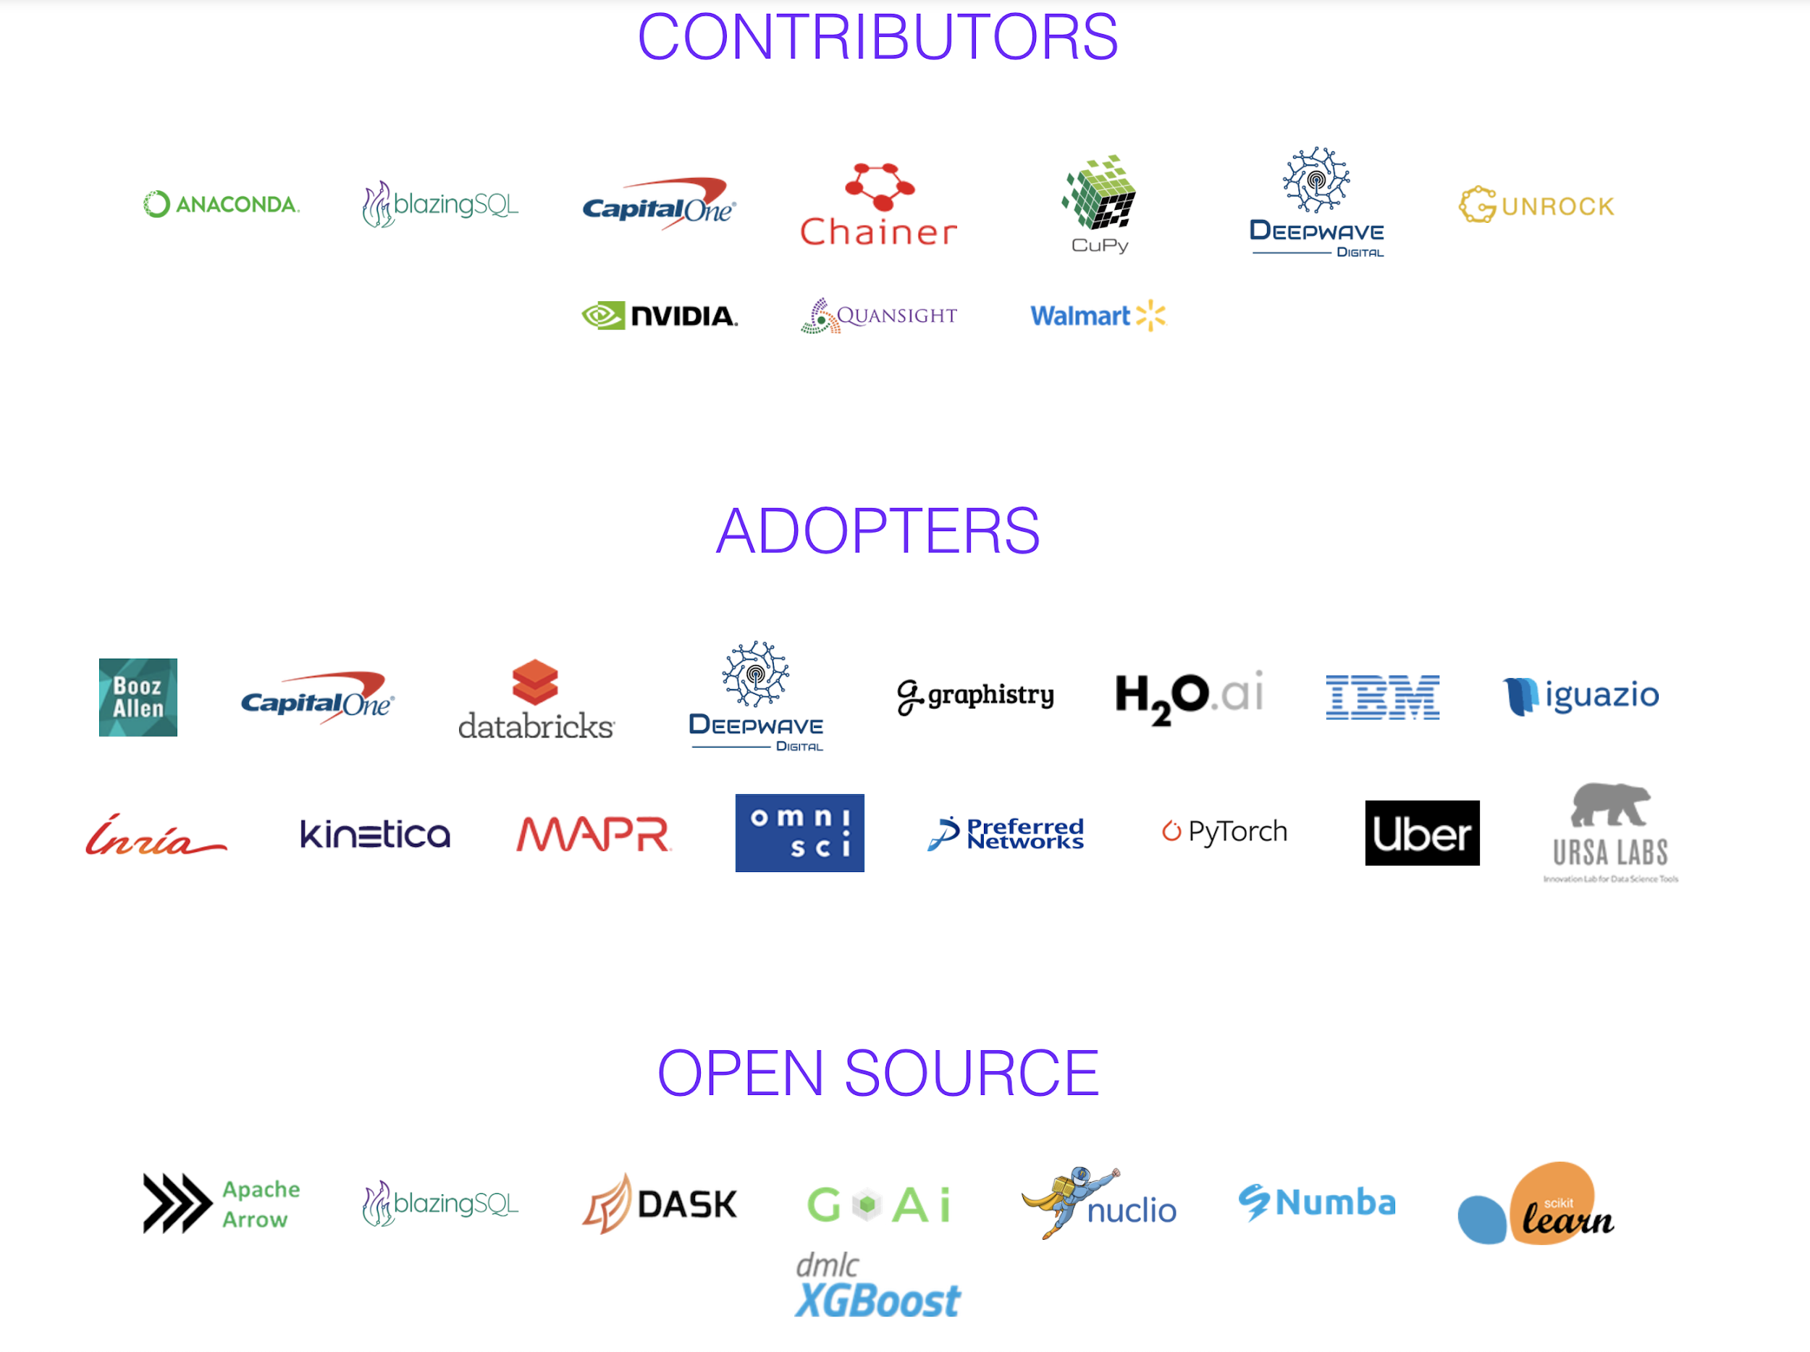
Ecosystem Partners

Slide 76


Building on top of RAPIDS
A bigger, better, stronger ecosystem for all
Streamz
High-Performance Serverless event and data processing that utilizes RAPIDS for GPU Acceleration
GPU accelerated SQL engine built on top of RAPIDS
Distributed stream processing using RAPIDS and Dask

Slide 77

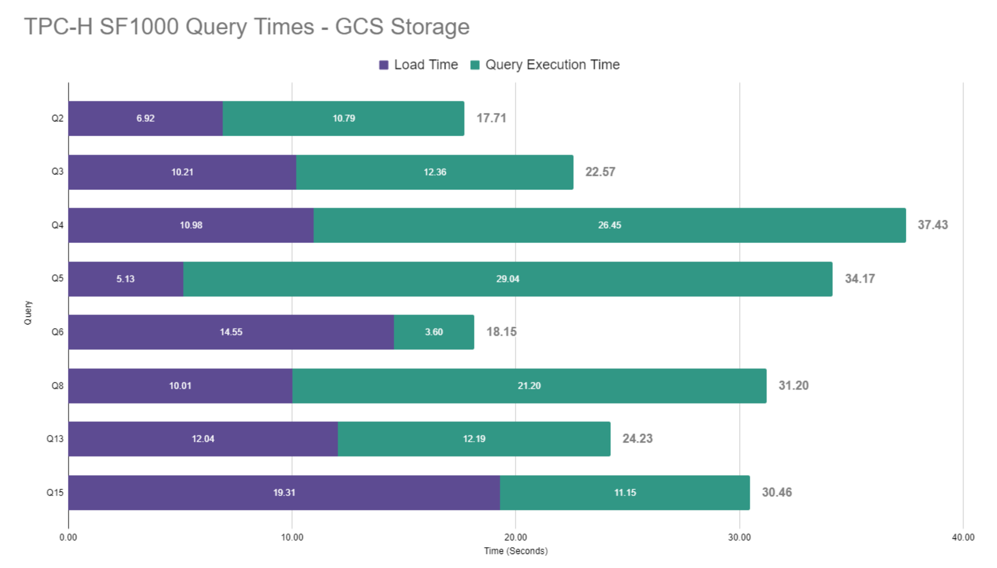




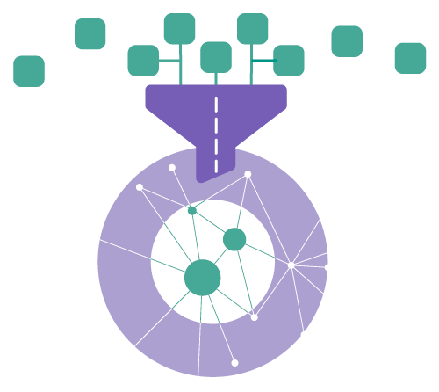

BlazingSQL
AI
blazingSQL
cuDF
cuML
cuGRAPH
SQL Queries
Data Preparation
Machine Learning
Graph Analytics
Apache Arrow on GPU

Slide 78


BlazingSQL
ETL
YOUR
DATA
MACHINE
LEARNING
Feature
Engineering
>
BlazingSQL
>
cuDF
>
cuML
CSV
GDF
Parquet
JSON
ORC
from blazingsql import BlazingContext import cudf bc = BlazingContext() bc.s('bsql', bucket_name='bsql', access_key_id='<access_key>', secret_key='<secret_key') bc.create_table('orders', s3://bsql/orders/') gdf = bc.sql('select * from orders').get()

Slide 79
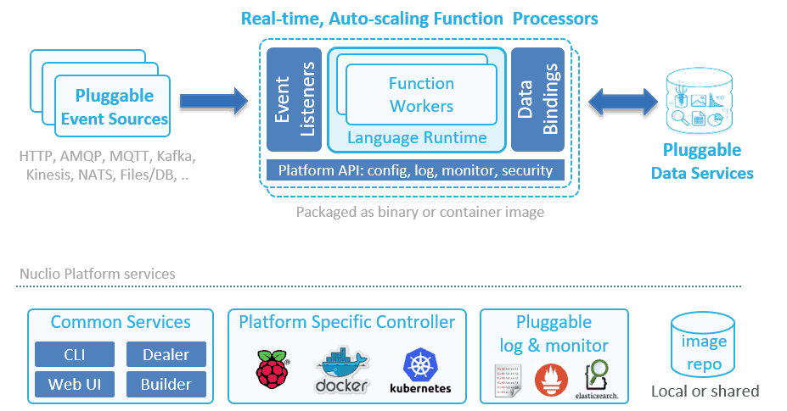
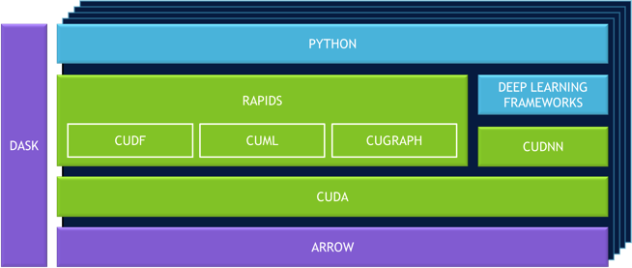
RAPIDS + Nuclio
Serverless meets GPUs
https://towardsdatascience.com/python-pandas-at-extreme-performance-912912b1047c

Slide 80








Deploy RAPIDS Everywhere
Focused on robust functionality, deployment, and user experience
Azure Machine Learning
Cloud Dataproc
Integration with major cloud providers
Both containers and cloud specific machine instances
Support for Enterprise and HPC Orchestration Layers

Slide 81
5 Steps to getting started with RAPIDS
Install RAPIDS on using Docker, Conda, or Colab
Explore our walk through videos, blog content, our github, the tutorial notebooks, and our examples workflows,
Build your own data science workflows.
Join our community conversations on Slack, Google, and Twitter
Contribute back. Don't forget to ask and answer questions on Stack Overflow

Slide 82
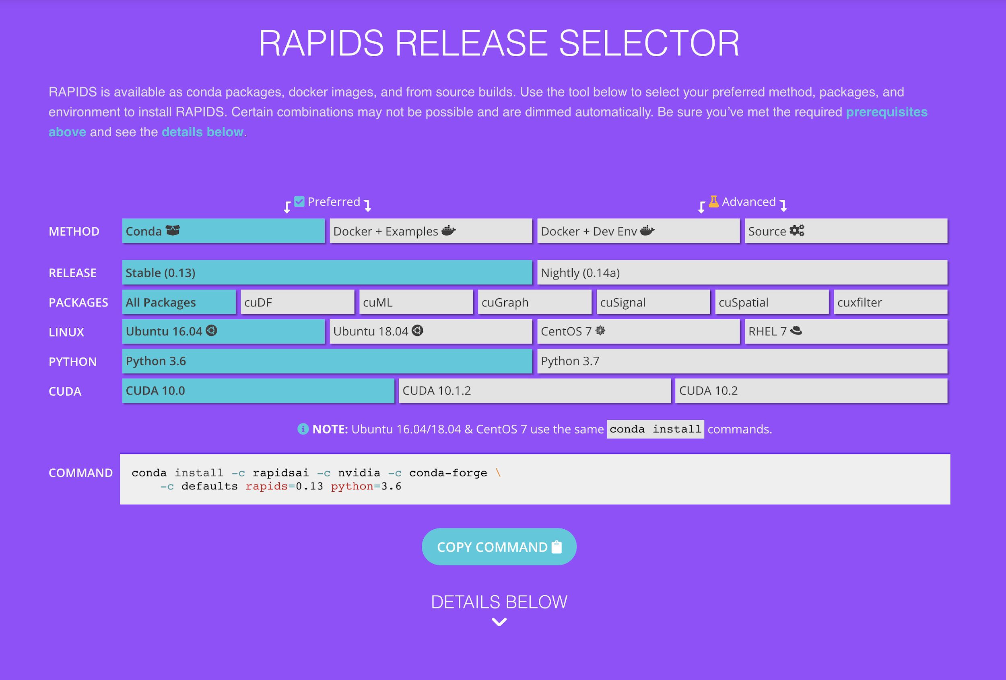
Easy Installation
Interactive Installation Guide

Slide 83
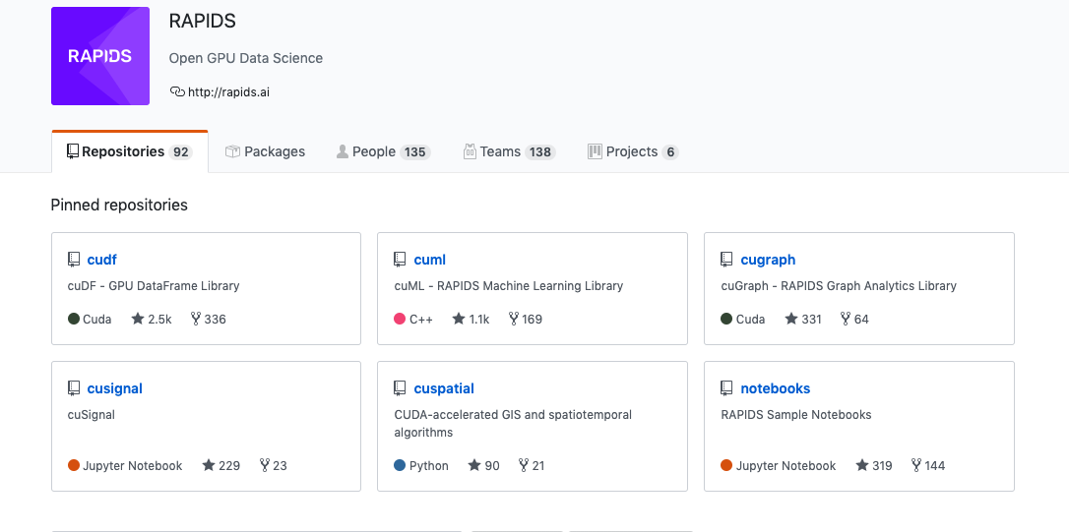
Explore: RAPIDS Github
https://github.com/rapidsai

Slide 84
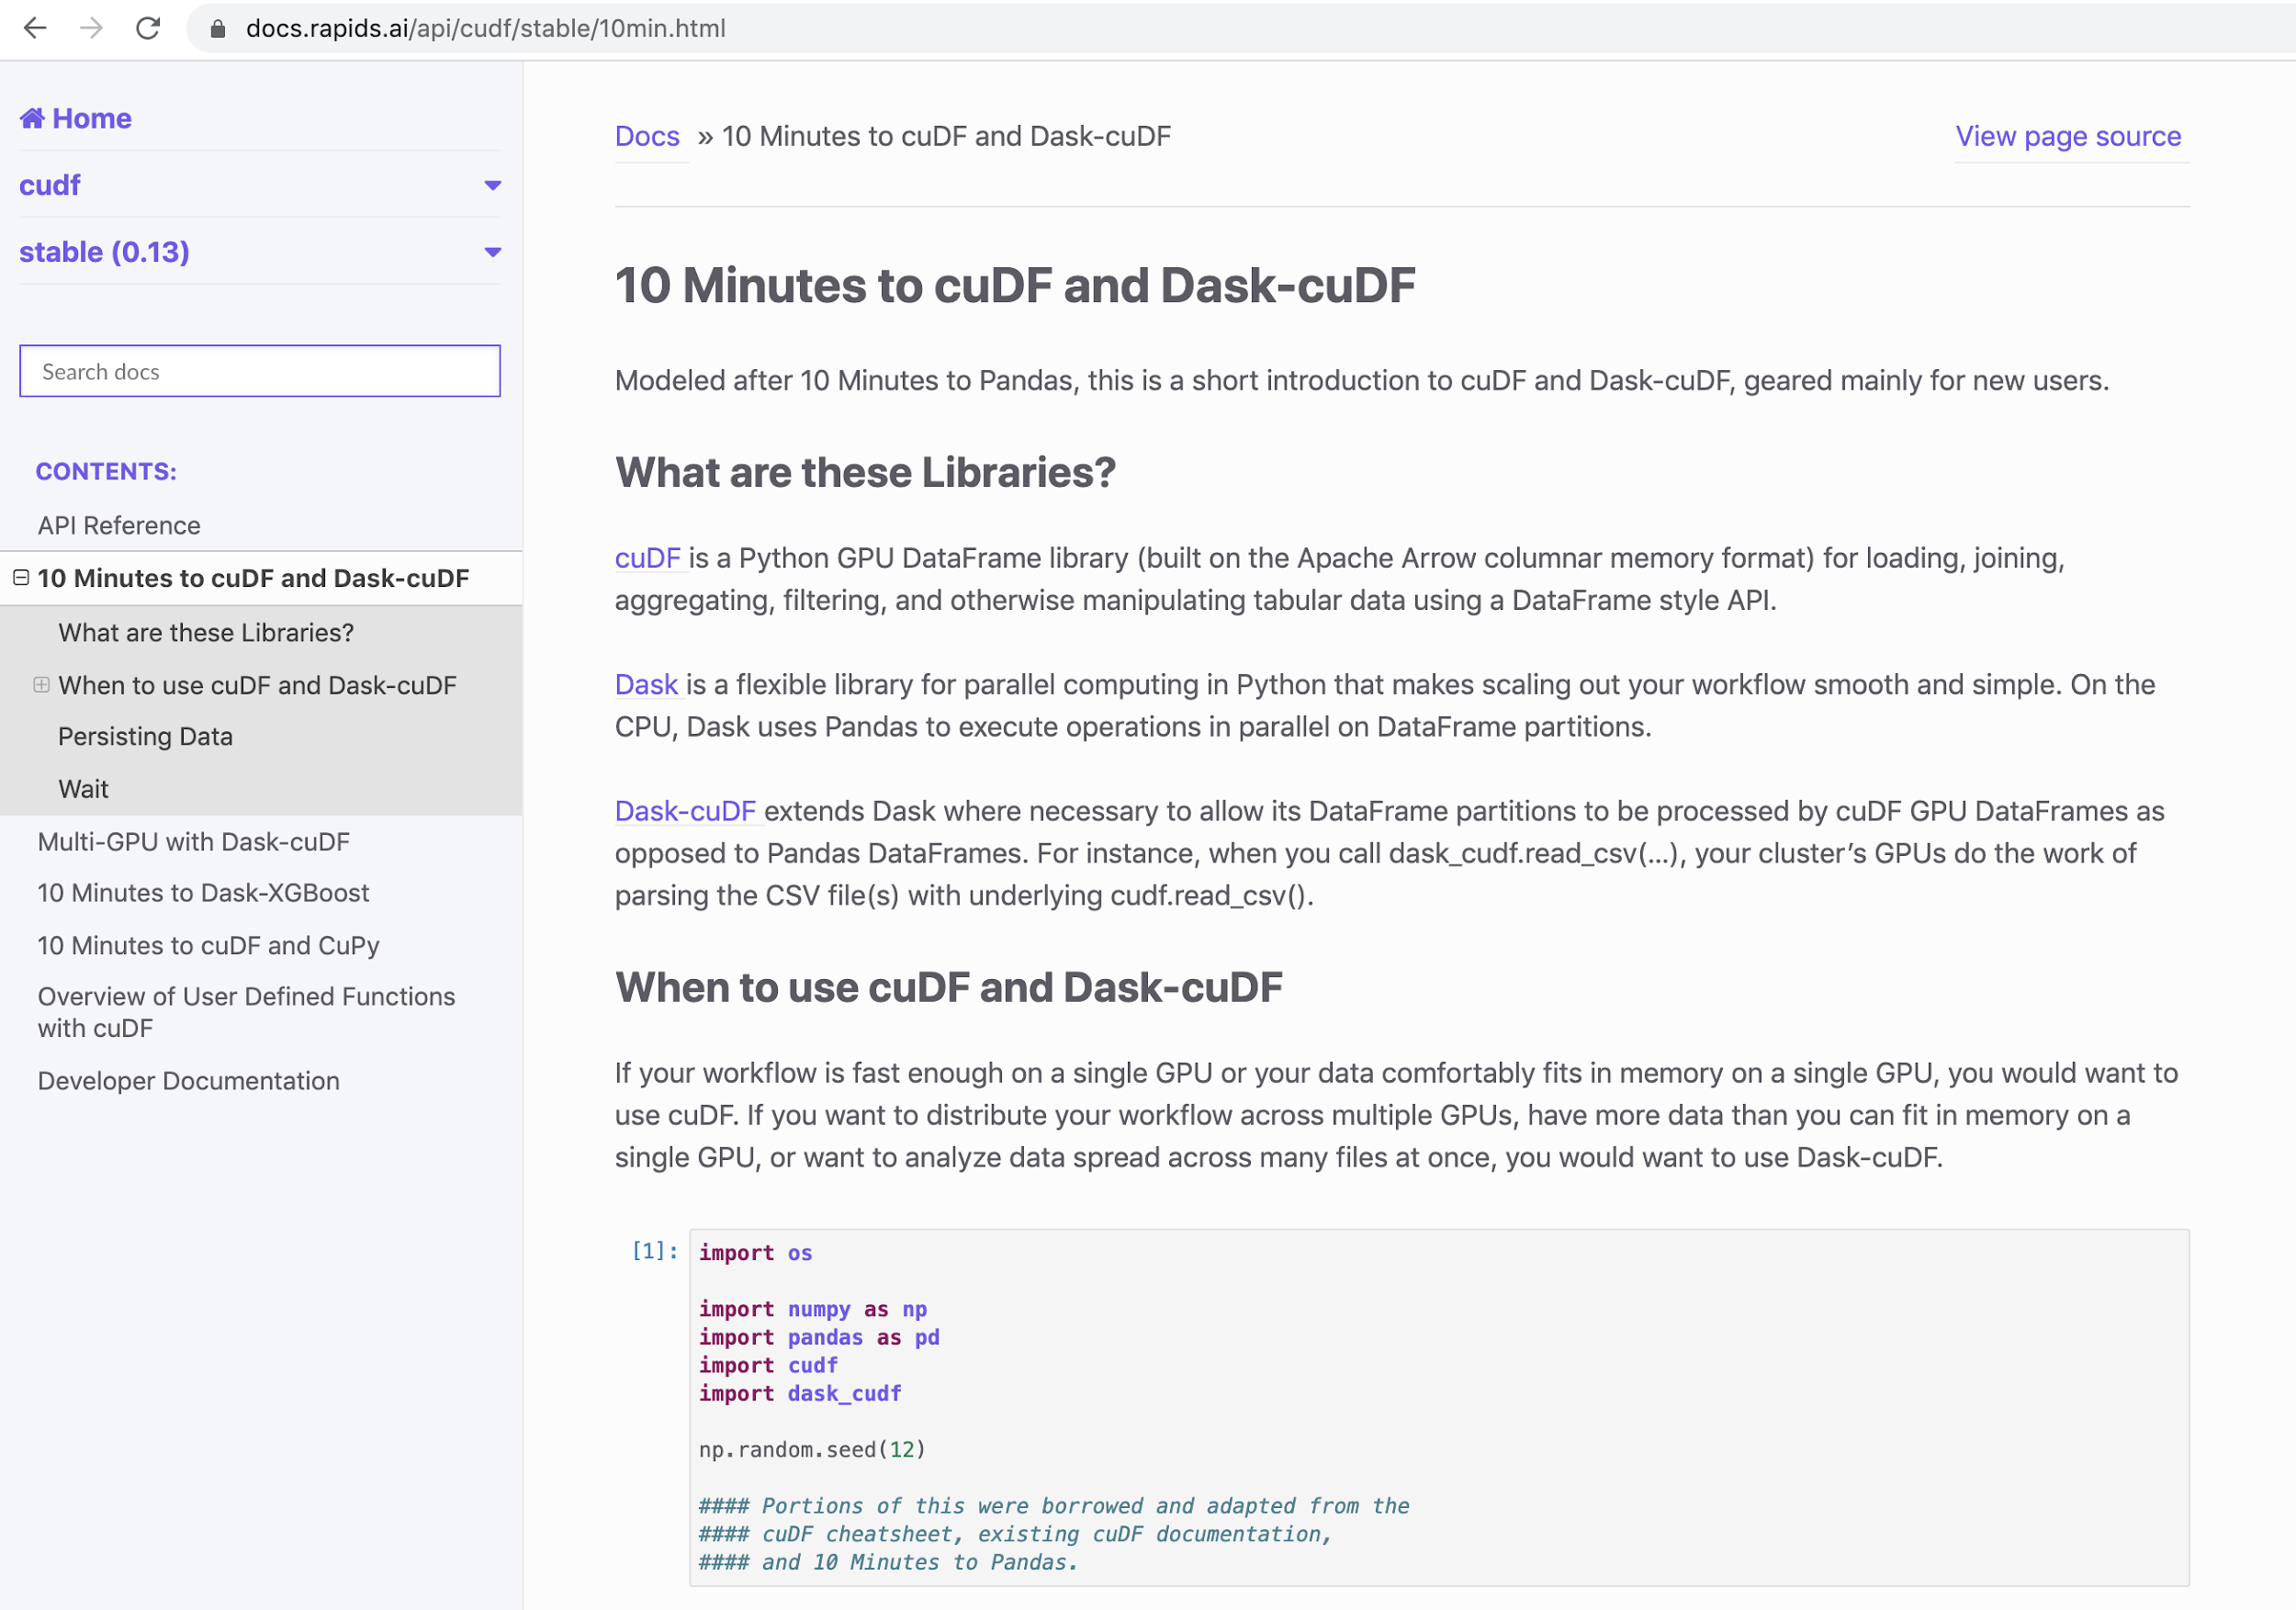
Explore: RAPIDS Docs
Improved and easier to use!
https://docs.rapids.ai

Slide 85
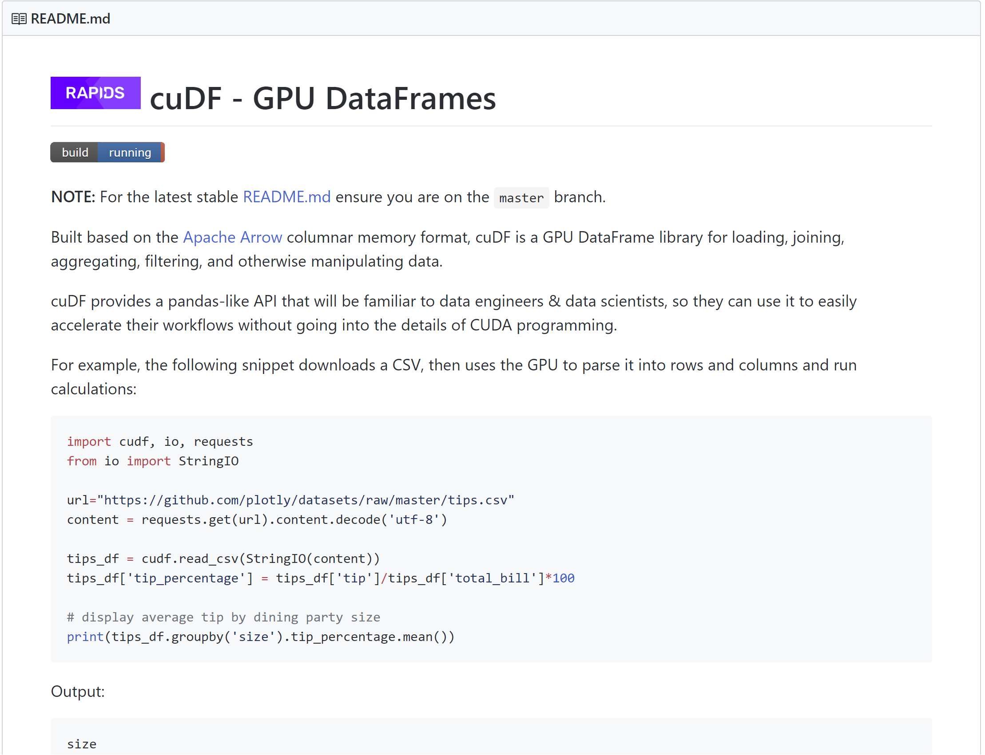
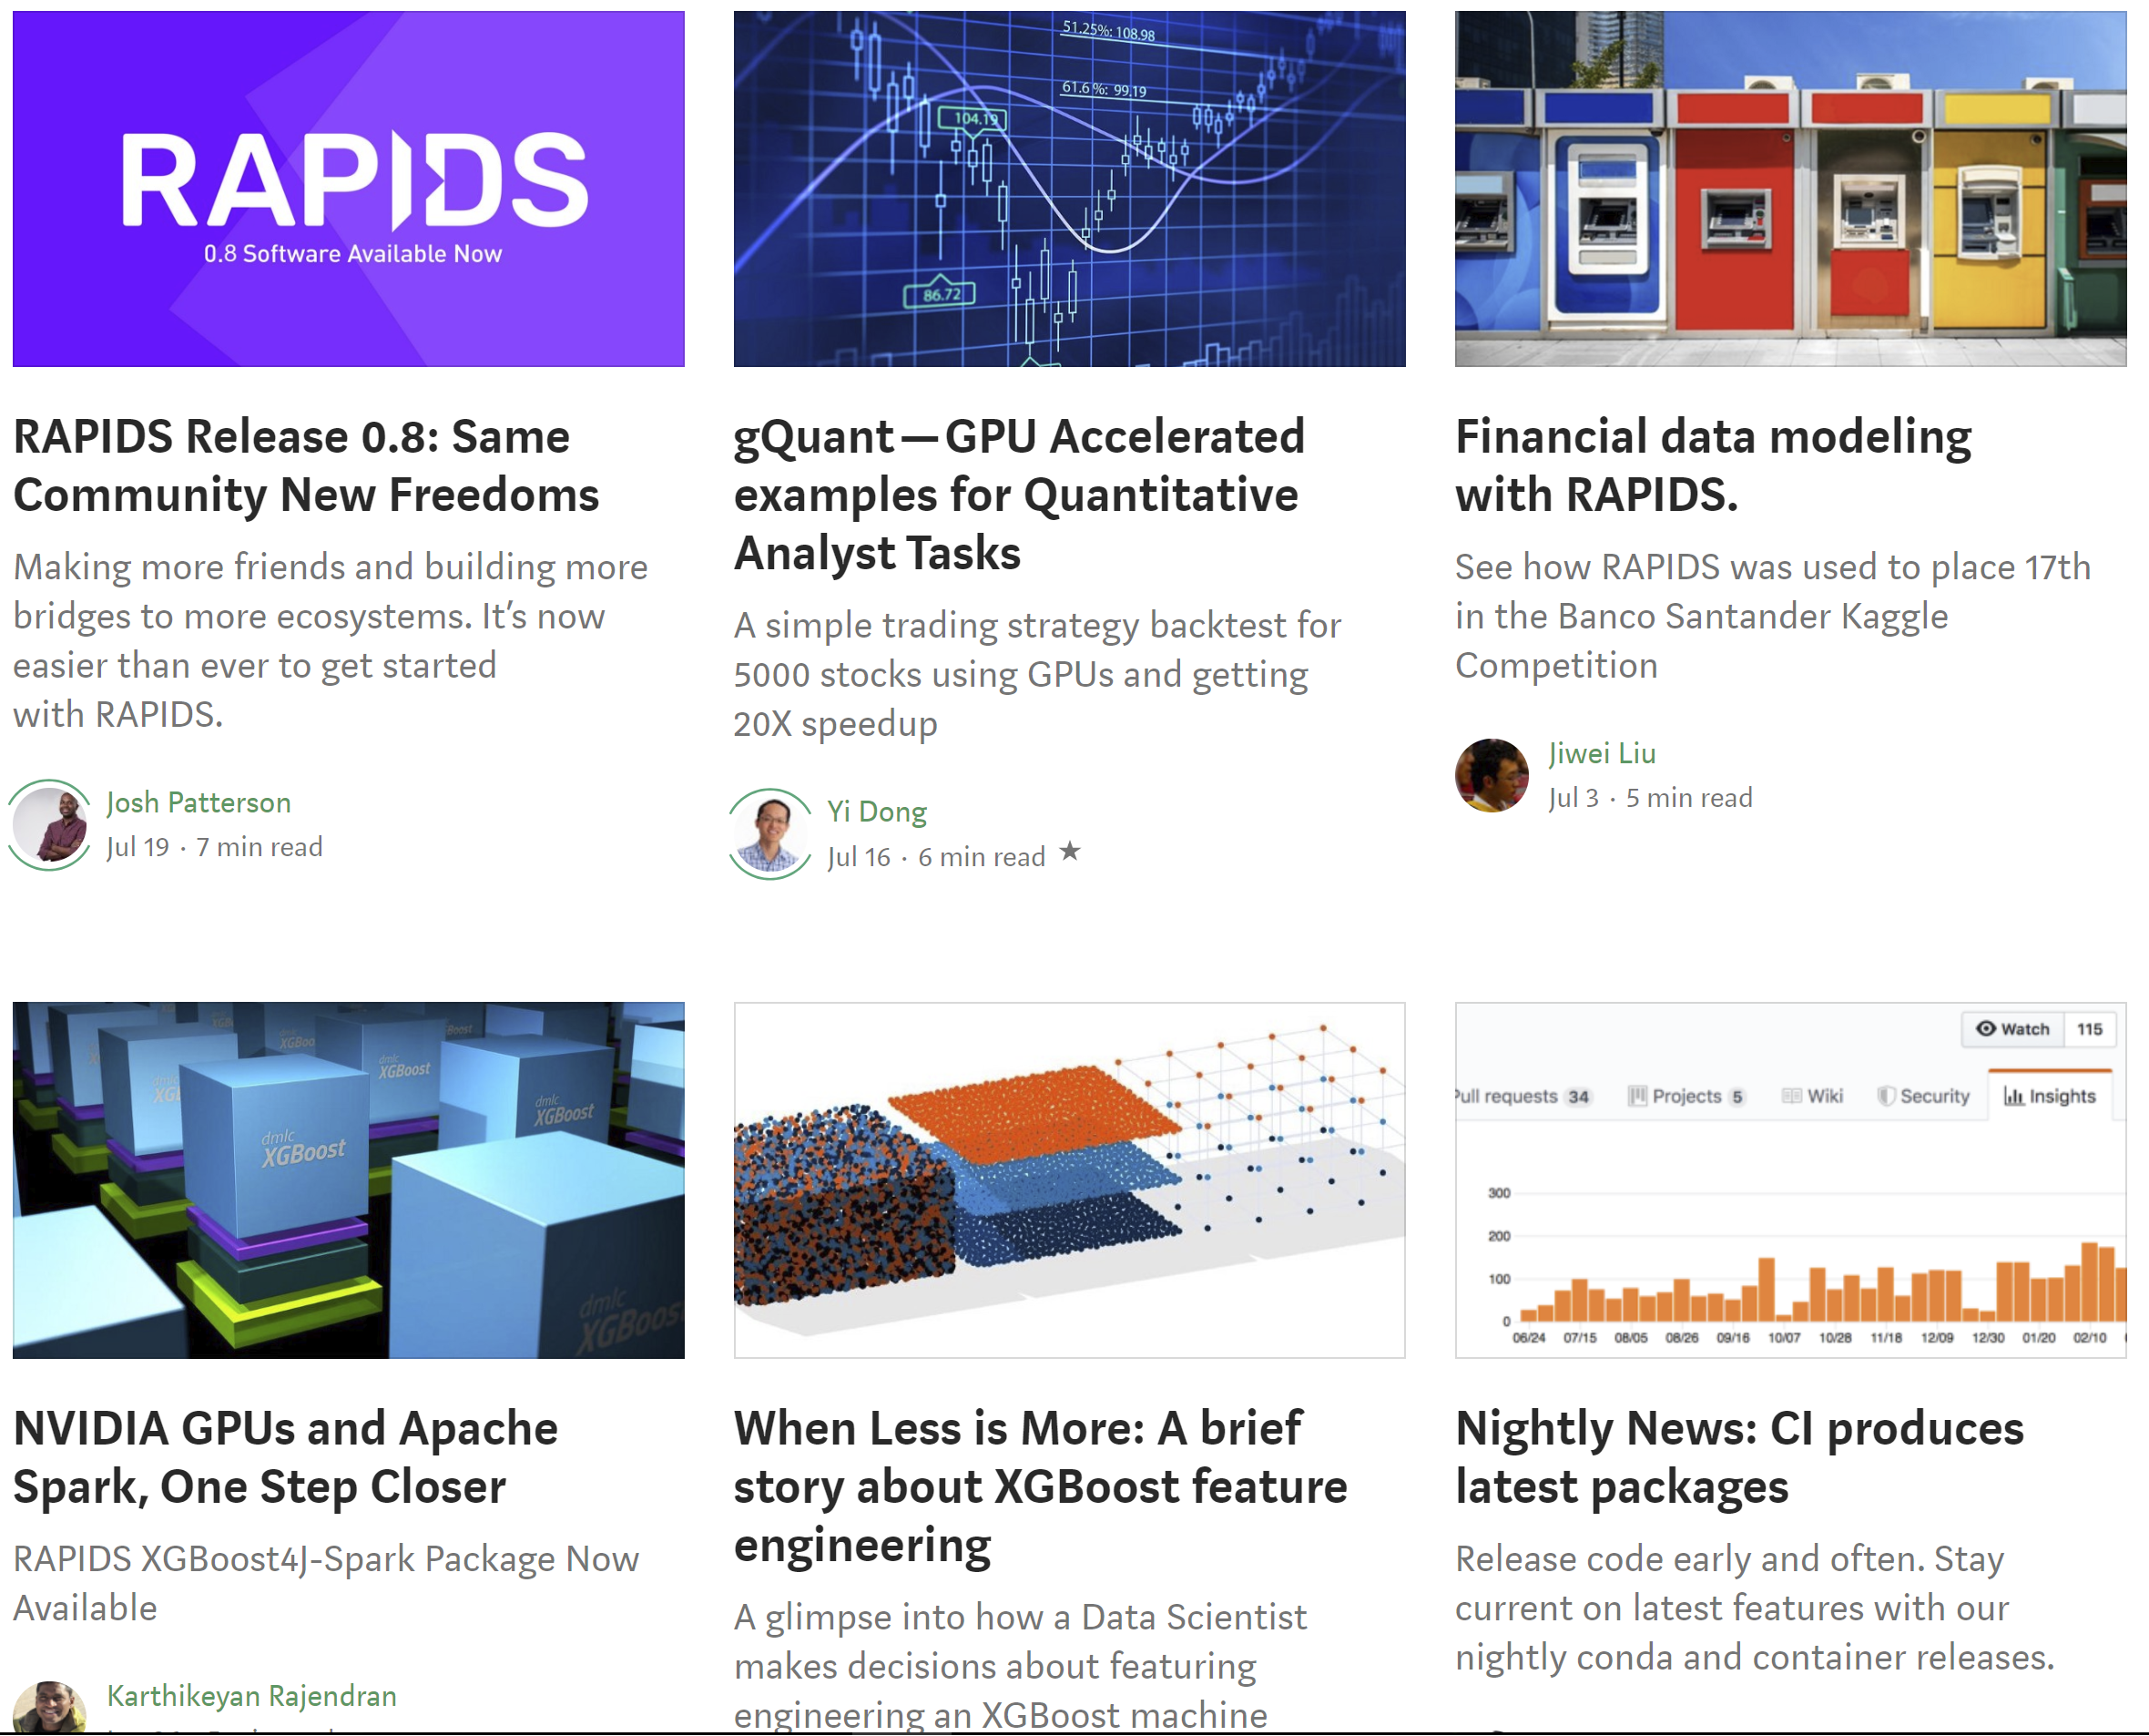
Explore: RAPIDS Code and Blogs
Check out our code and how we use it
https://github.com/rapidsai
https://medium.com/rapids-ai

Slide 86
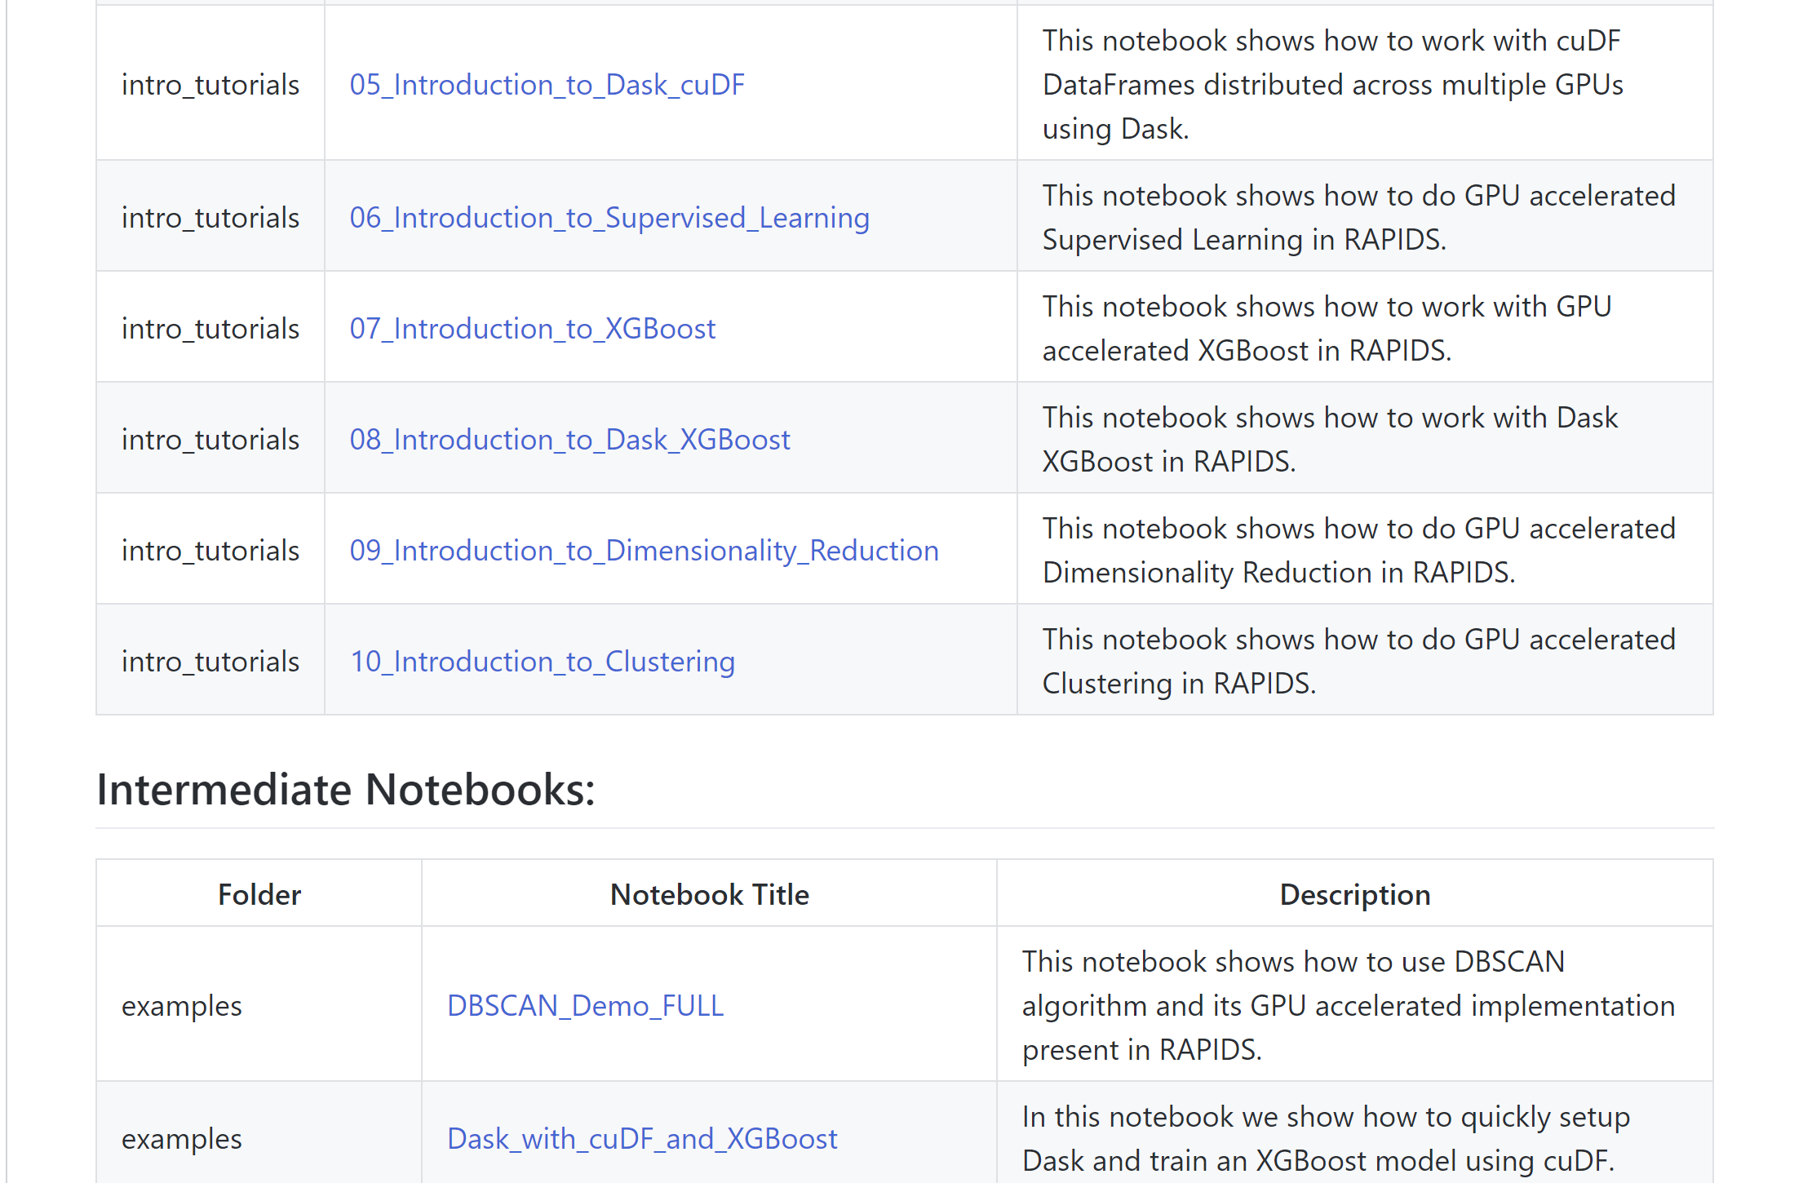
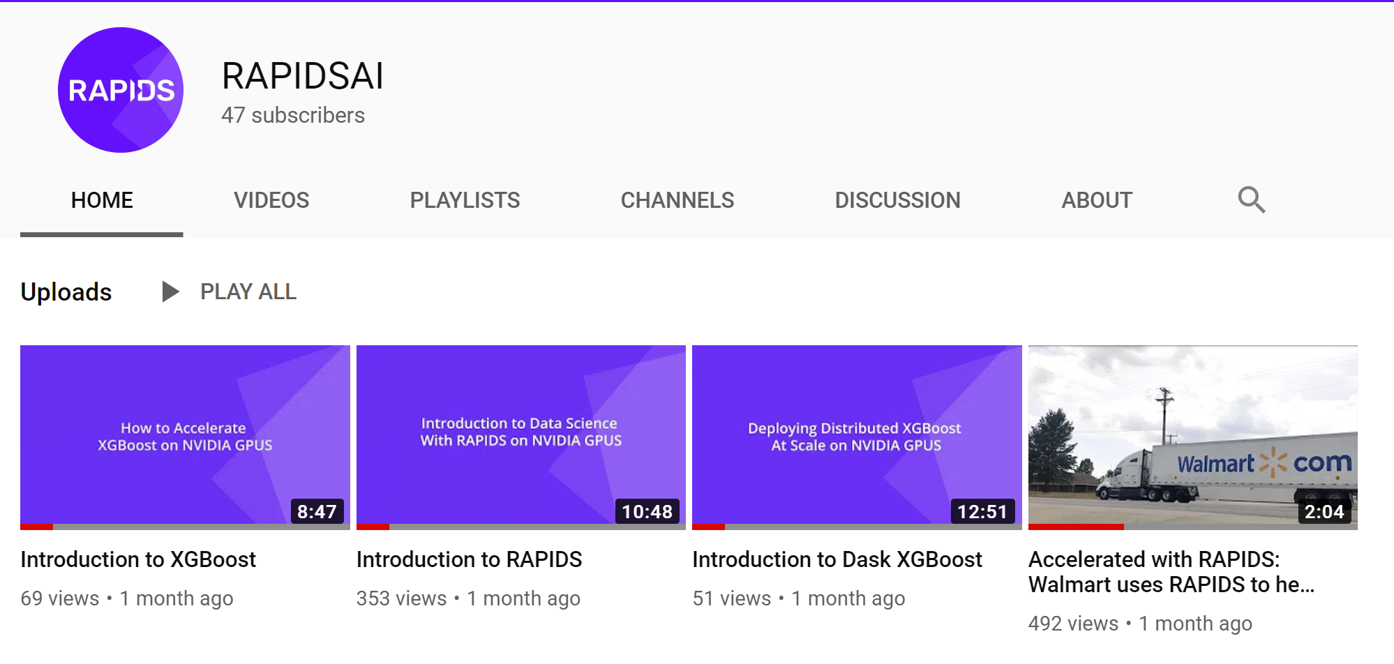
Explore: Notebooks Contrib
Tutorials, examples, and various E2E demos available, with Youtube explanations, code walkthroughs and use cases

Slide 87

Join the Conversation

Slide 88
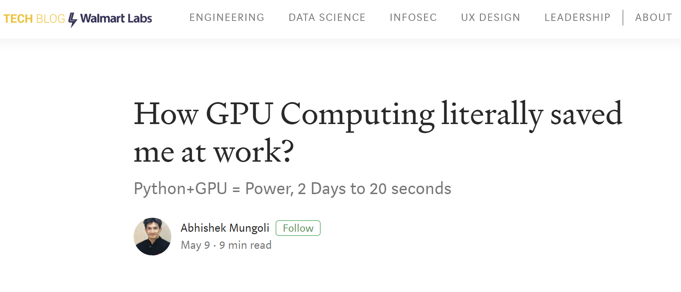



Contribute Back
Issues, feature requests, PRs, Blogs, Tutorials, Videos, QA...bring your best!

Slide 89
Getting Started

Slide 90

RAPIDS Docs
New, improved, and easier to use
https://docs.rapids.ai

Slide 91

RAPIDS Docs
Easier than ever to get started with cuDF

Slide 92




RAPIDS
How do I get the software?
https://github.com/rapidsai
https://anaconda.org/rapidsai/
https://ngc.nvidia.com/registry/nvidia-rapidsai-rapidsai
https://hub.docker.com/r/rapidsai/rapidsai/

Slide 93




Join the Movement
Everyone can help!
APACHE ARROW
RAPIDS
Dask
GPU Open Analytics Initiative
https://arrow.apache.org/
https://rapids.ai
https://dask.org
http://gpuopenanalytics.com/
@ApacheArrow
@RAPIDSAI
@Dask_dev
@GPUOAI
Integrations, feedback, documentation support, pull requests, new issues, or code donations welcomed!

Slide 94

THANK YOU
Joshua Patterson @datametrician
joshuap@nvidia.com

